Slide 1

Cosmographia Workshop
Alfredo Escalante
Ricardo Vallés
Rafael Andrés
ESA SPICE Service
12th December 2023

Slide 2

Agenda
9:00 – 9:30 | Class Introduction
9:30 – 10:30 | Cosmographia settings, controls and display options
10:30 – 11:10 | Setting ESA missions scenario
11:10 – 11:30 | Coffee break
11:30 – 12:30 | Loading catalog files (sensors, observations, shape models)
12:30 – 13:00 | Summary
13:00 – 14:00 | Lunch
14:00 – 15:00 | Scripting
15:00 – 15:30 | Cosmographia JUICE plugin
15:30 – 16:00 | Open topics

Slide 3
Class Introduction
NAIF offers for public use a SPICE-enhanced version of the visualization tool Cosmographia.
  Available for Windows, Mac and Linux.
This is an interactive tool used to produce 3D visualizations of:
  Planets; moons; asteroids; comets; ephemerides, sizes and shape models
  Spacecraft trajectories and orientations
  Instrument field-of-views and footprints
Cosmographia has many user controls, allowing one to manage what and how is displayed, the point of view position and aperture, how fast the animation progresses and more.
The ESA SPICE Service provides the setup and instructions to load the SPICE supported ESA Missions in Cosmographia.

Slide 4
Class Introduction
The purpose of this class is to show how to first setup Cosmographia and use it for the ESA missions.
We want you to get hands-on Cosmographia!
The key points we will cover:
  Install Cosmographia (if you have not done it before)
  Getting familiar with the Cosmographia Interface, controls and visualization options
  Downloading SPICE Kernel Dataset and configuring the Cosmographia scenario
  Loading catalog files: sensors, observations, shape models
  Modifying catalog files
  Cosmo-scripting
  Cosmographia JUICE plugin
  Open Discussions

Slide 5
Installing Cosmographia
Cosmographia can be downloaded from the NAIF or ESA SPICE Service sites.
  NAIF: https://naif.jpl.nasa.gov/naif/cosmographia_components.html
  ESS: https://www.cosmos.esa.int/web/spice/cosmographia

Slide 6
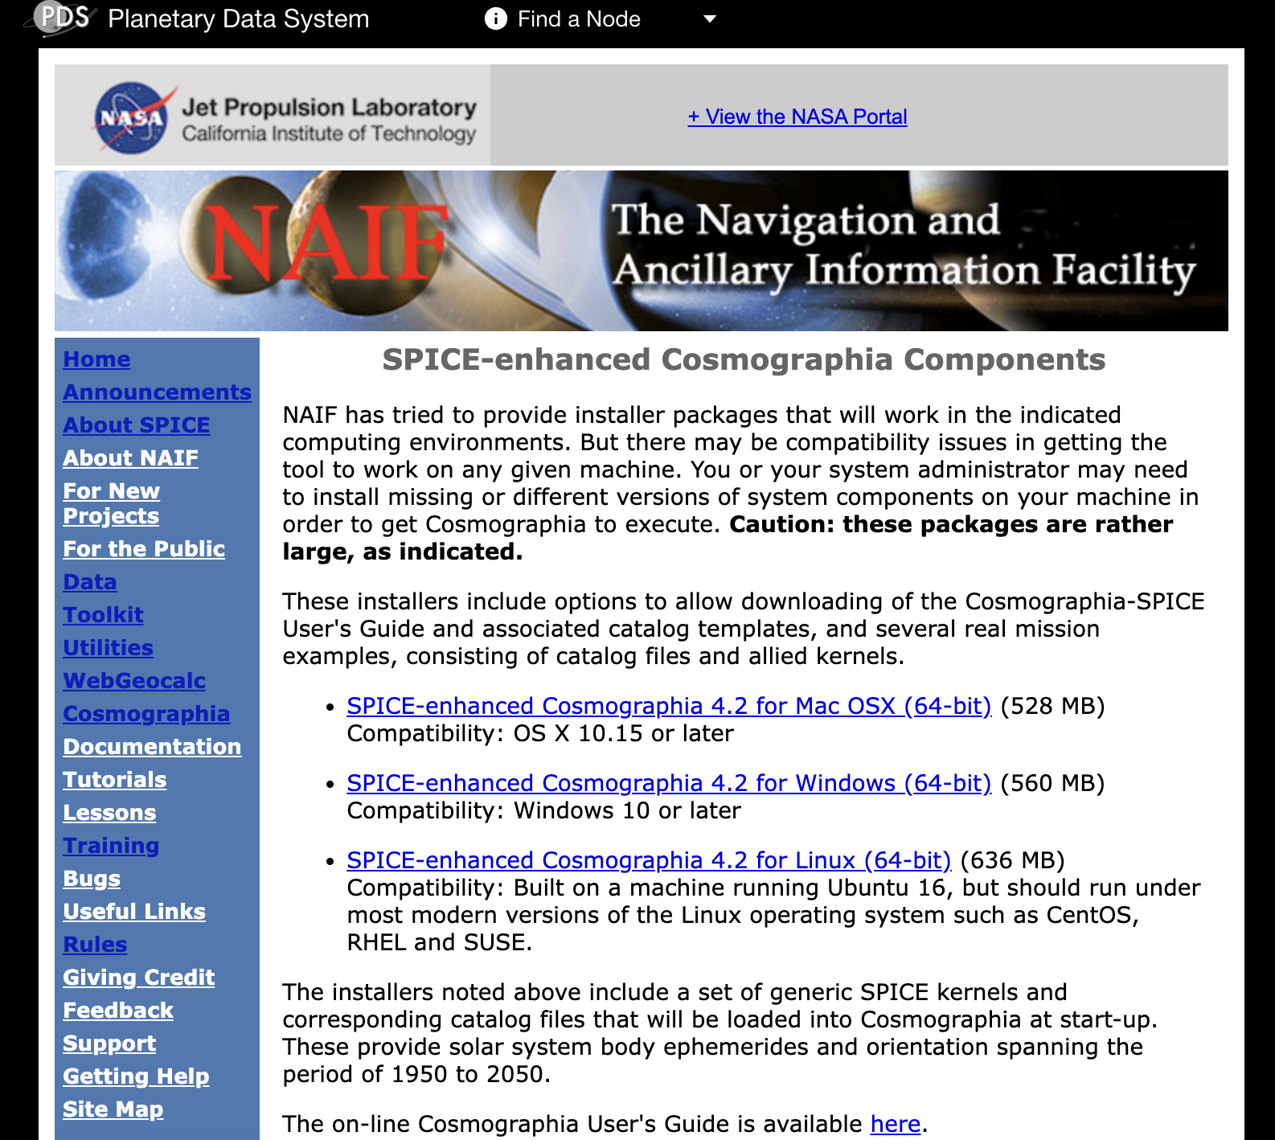
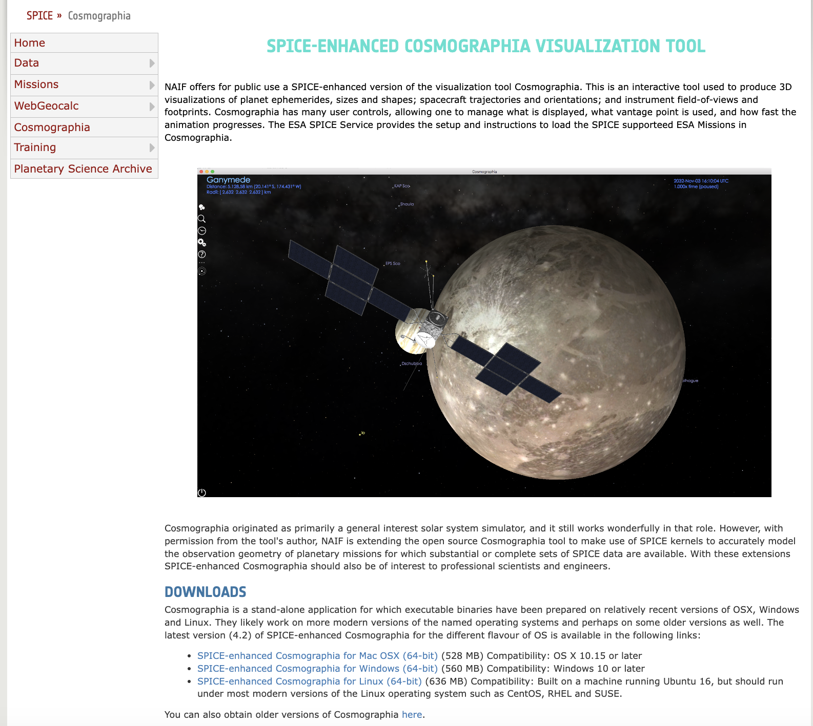
Installing Cosmographia

Slide 7
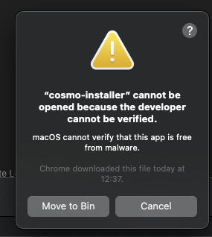
Installing Cosmographia
Cosmographia is NOT available in the esa365 catalogue but should not require admin permissions to be installed.
Download the installer for your platform from any of the previous links and place it in a directory different from the default Apps/Programs directory
In Mac you may get the warning of “unknown developer”
  Hold control key and left-click the installer
  Then hit Open
  You may get the warning again, just hit cancel and do it again
  After a couple of times you should get the wizzard running
Follow the installation steps and again select an appropriate directory for installing Cosmographia
  It can be wherever you want in your computer, does not have to be with the kernels
  Just DO NOT choose the default Apps directory as esa365 may block the app from running

Slide 8
Installing Cosmographia
In Windows we have encountered an issue for some users with Cosmographia 4.2.
The setup completes without errors but it is not possible to launch the app after the installation.
NAIF is investigating the issue but have not found a workaround yet.
  Suspect is incompatibility between some visual libraries.
For those users, we recommend either:
  Installing Cosmographia on a Linux virtual machine.
  Installing Cosmographia 4.1 (cosmoscripting for Windows is not available for < 4.2)
If you encounter any issues during installation please let us know!

Slide 9
Cosmographia Interface
Hands-on explore the Cosmographia interface:
Solar System Objects
Find Object (cmd + f)
  Point at, Go to
Time Control
  Select date and Time rate
  Select Time and Date (cmd + t)
  Pause/Resume time (cmd + p); Fast-forward x10 (cmd + l), Slow down /10 (cmd + k), Reverse (cmd + j)
Settings
  Graphics: Atmospheres/Clouds (Earth, Venus, Titan), Shadows, Star Birghtness, Extra Light
  Guides: Orbits, Labels, Stars and Constellations, Text and Vectors sizes
  Interface: Spice Driven Bodies, Units, Record Video Resolution
  Add-ons: All asteroids, Enceladus’ Geysers
Help: User’s Guide, Navigation Basics, Keyboard shortcuts

Slide 10
Cosmographia Interface
File
  Open Catalog, Screenshot/Record, Run script
Time menu
Camera
  Find, Go to object
  Inertial Frame, Body Fixed Frame
Guides
Window

Slide 11
Navigation Basics
Camera Motion
  Double click to an object to go close to it and select it
  Scroll down/up for zoom in/out
  Left drag the mouse to move the camera aroung the central object
  Right drag the mouse to pan the view without chaning camera position
  Shift + right drag (or pinch the trackpad) to change the field-of-view of the camera (default 50 degrees)
Displaying things with right click on objects
  Point at, Go to, Set as center, Set as Fixed center, Track
  Reference frames: Inertial, Body Fixed, SPICE Frames
  Directions: Velocity, Sun, Earth, Secondary-to-Object (click on secondary and right click on object)
  Distance from secondary to object
  Trajectory, Lon/Lat grid, Terminator

Slide 12
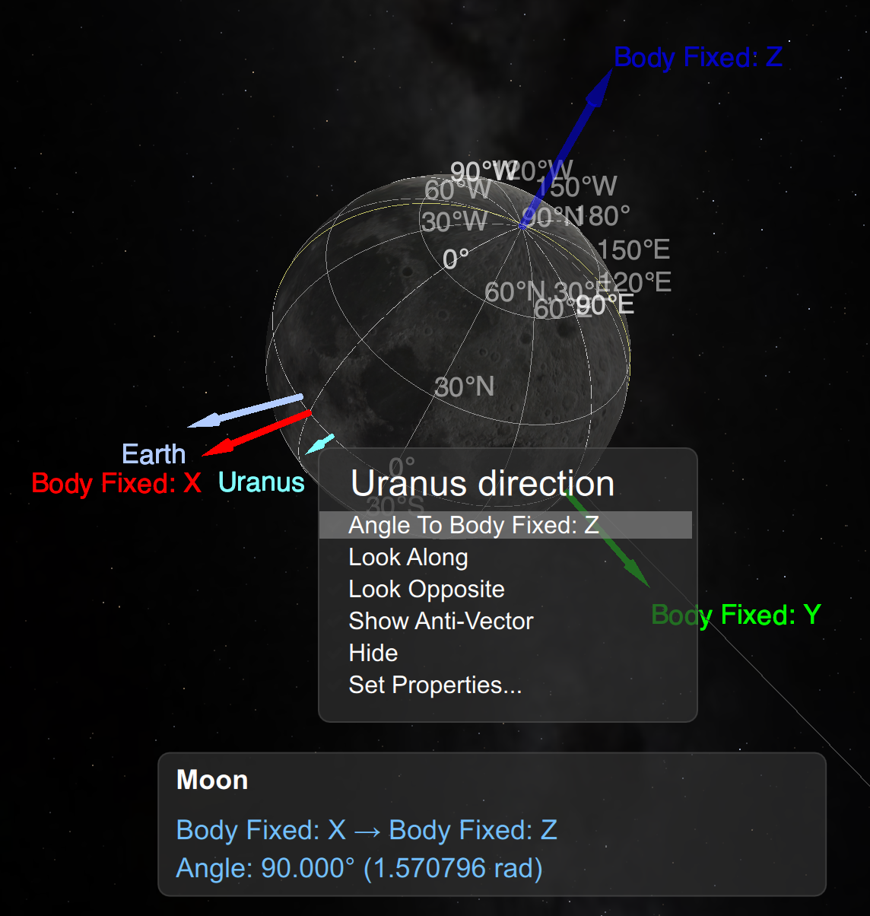
Navigation Basics
Single Vector options: Select (left click) object with vector and right click on vector
  Look Along (specially useful for Direction vectors or Instrument Boresights)
  Look Opposite
  Show anti-vector
  Hide and Show Properties
Two Vectors options:
  Select (left click) object with primary vector, left click on primary vector and right click on secondary vector.
  Angle from Primary Vector to Secondary Vector

Slide 13
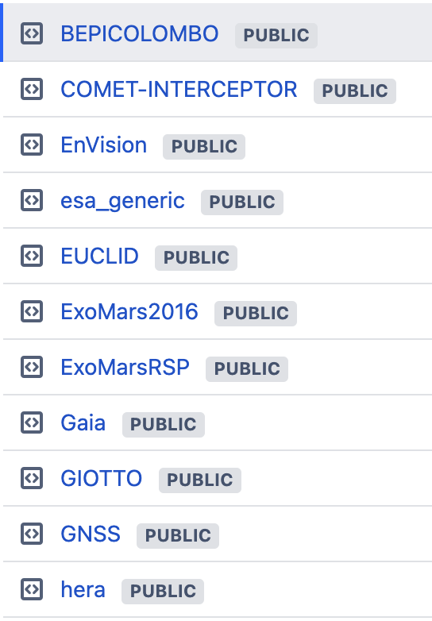
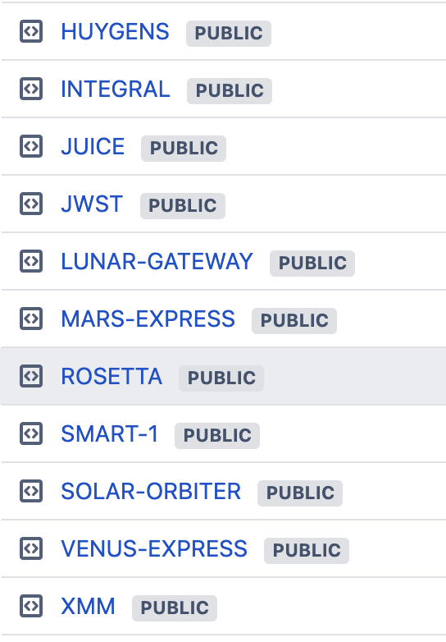
Configuration for ESA missions
The ESA SPICE Service provides SPICE Kernel Datasets for a large set of missions:

Slide 14
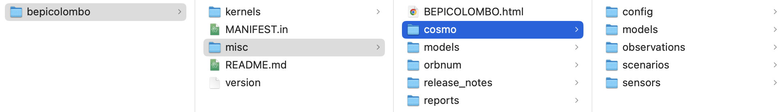
Configuration for ESA missions
The SPICE Kernels and Cosmographia configuration for each mission can be downloaded from:
  BitBucket: https://s2e2.cosmos.esa.int/bitbucket/projects/SPICE_KERNELS ← Best Option!
    git clone --depth 1 https://s2e2.cosmos.esa.int/bitbucket/scm/spice_kernels/bepicolombo.git
  FTP/HTTPS: http://spiftp.esac.esa.int/data/SPICE/
    ZIP file: http://spiftp.esac.esa.int/data/SPICE/BEPICOLOMBO/misc/skd/BEPICOLOMBO.zip
After cloning/downloading the SPICE Kernel Dataset (SKD), there are just two steps to configure the mission:
  Create local copy of the meta-kernel: mv kernels/mk/bc_plan.tm kernels/mk/bc_plan_local.tm
  Update the PATH_VALUES in the local meta-kernel with the absolute path to your kernels directory
    PATH_VALUES = ( '/Users/aescalante/spice/missions/bc/bepicolombo/kernels' )
IMPORTANT!

Slide 15
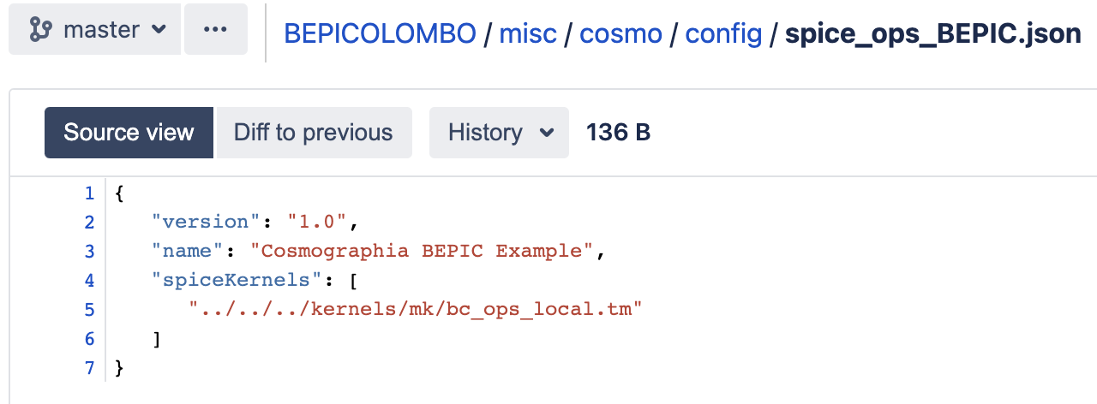
Brand new Git Hooks!
The previous steps are mandatory to prepare a meta-kernel with an absolute path to the kernels that Cosmographia can load to access the data:
We have prepared a git hook distributed with the SKD in BitBucket to automatically do this!
  http://spiftp.esac.esa.int/temp/ess/git_hooks.zip
  Either run the script update_local_mks.sh from the SKD root folder to configure the local met—kernels
    Linux and Mac: cd [SKD_PATH] && ./misc/git_hooks/skd_post_merge/update_local_mks.sh
    Windows: cd [SKD_PATH] , misc/git_hooks/skd_post_merge/update_local_mks.bat
  Or install the git hooks so every time you pull updates or checkout branches the meta-kernels are automatically updated.

Slide 16
Brand new Git Hooks!
To install the git hooks:
  For OS X or Linux:
    cd [SKD_PATH]
    chmod +x misc/git_hooks/skd_post_merge/install_hook_linux_or_mac.sh
    ./misc/git_hooks/skd_post_merge/install_hook_linux_or_mac.sh
  For Windows:
    cd [SKD_PATH]
    misc\git_hooks\skd_post_merge\install_hook_windows.bat

Slide 17
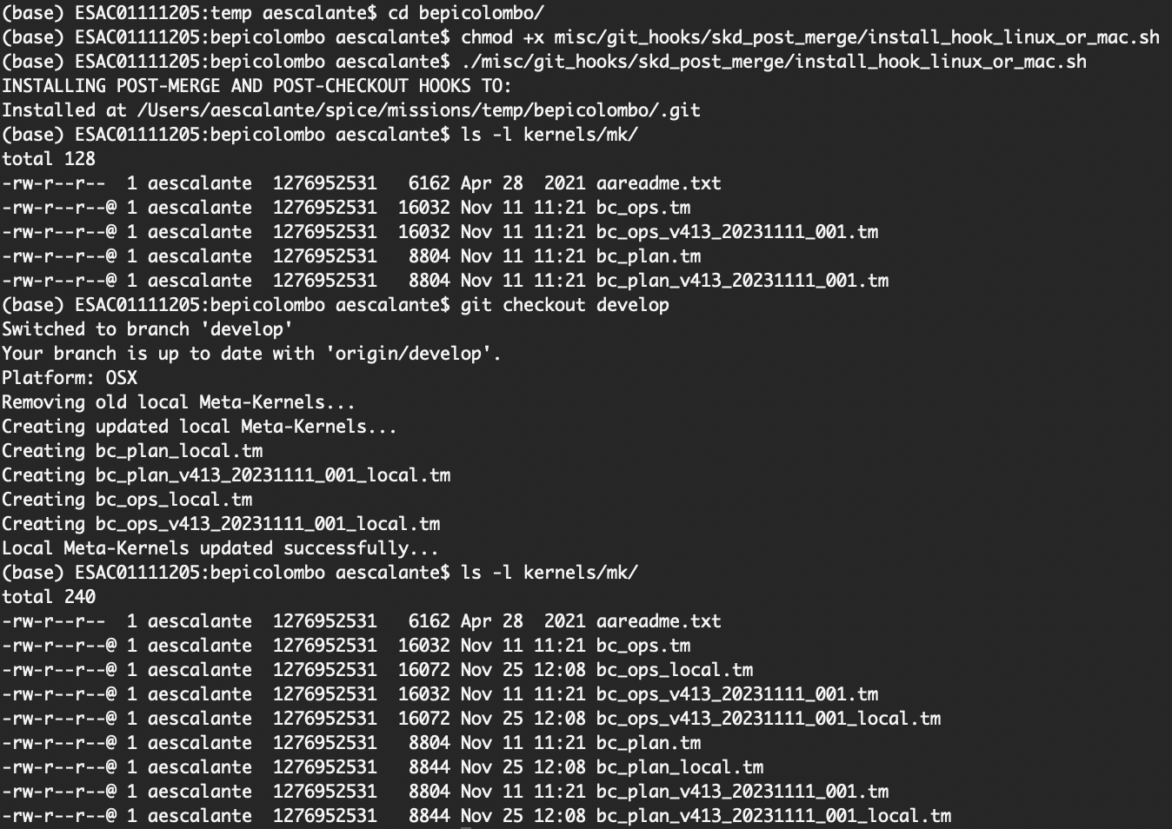
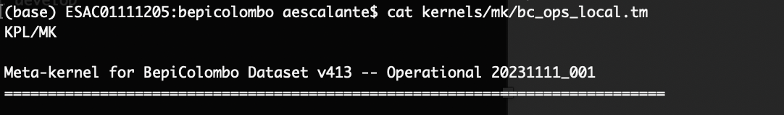
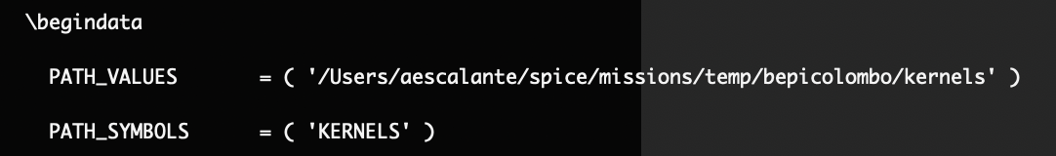
Brand new Git Hooks!

Slide 18
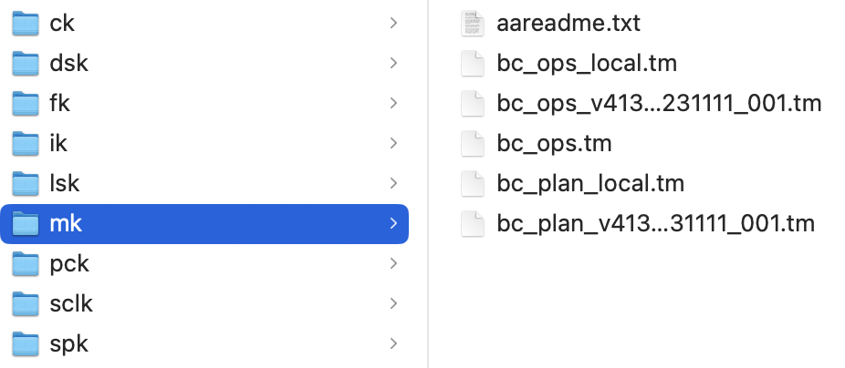
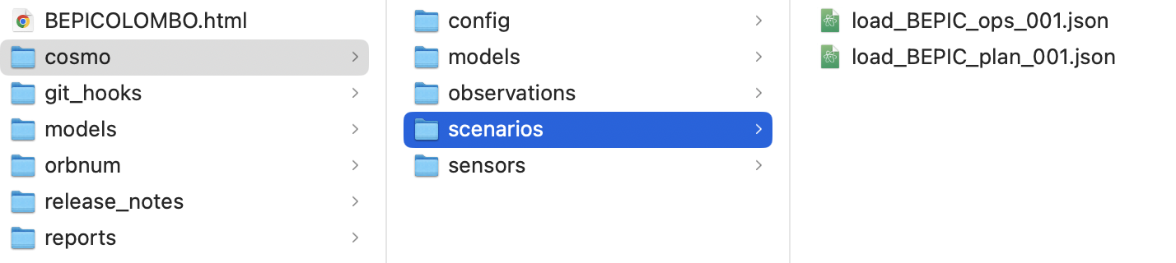
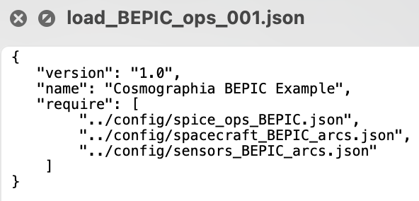
Loading the mission scenario
Once the local meta-kernels are ready, we can go back to Cosmographia and load the mission scenario.
Scenarios are the main file to be loaded to get the pre-configured mission into Cosmographia.
In principle, there is a different scenario file for each meta-kernel in the SKD:

Slide 19
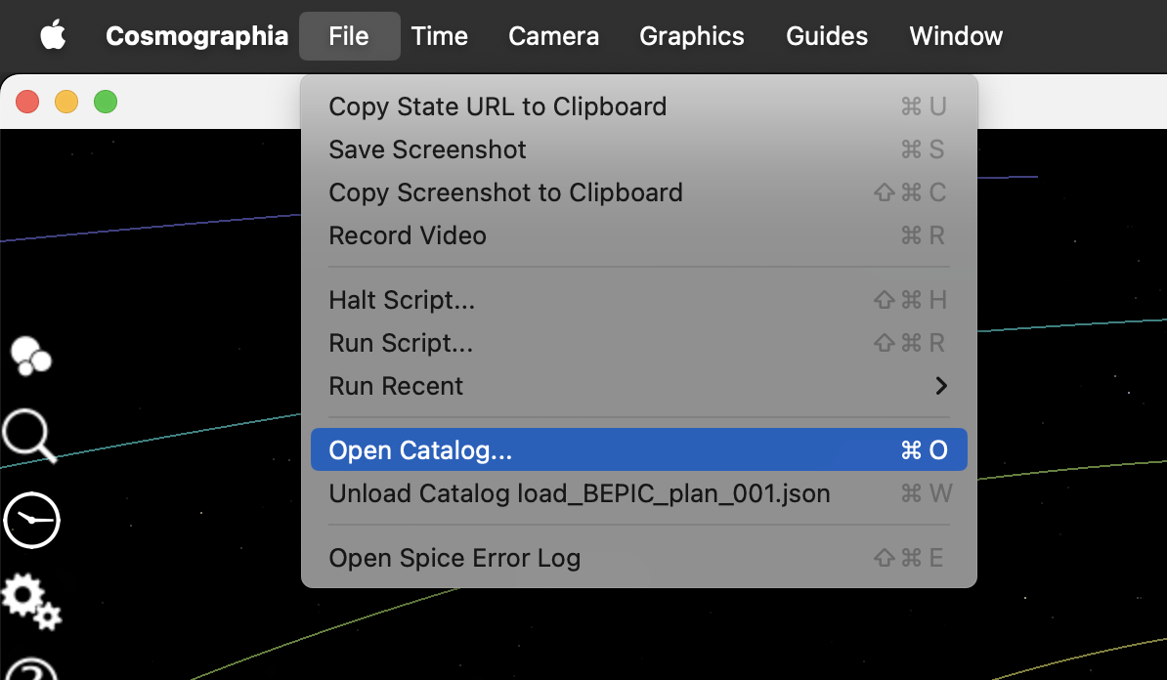
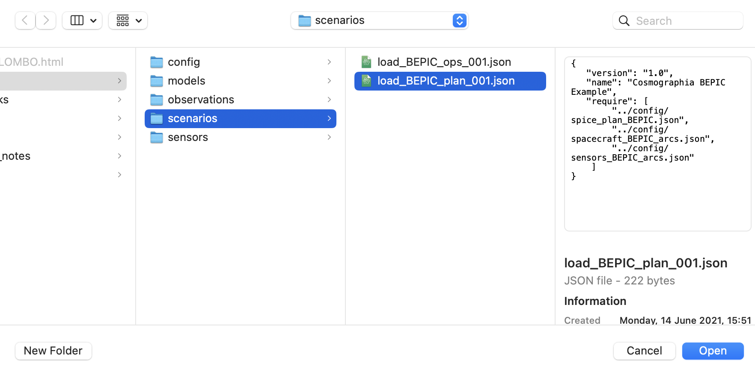
Loading the mission scenario
In Cosmographia, hit File at the top-bar menu and select Open Catalog… (cmd + o)
                As in SPICE, loading multiple catalog will result in the last one overriding the previous one.
                To unload a catalogue click Unload Catalog (cmd + w)

Slide 20
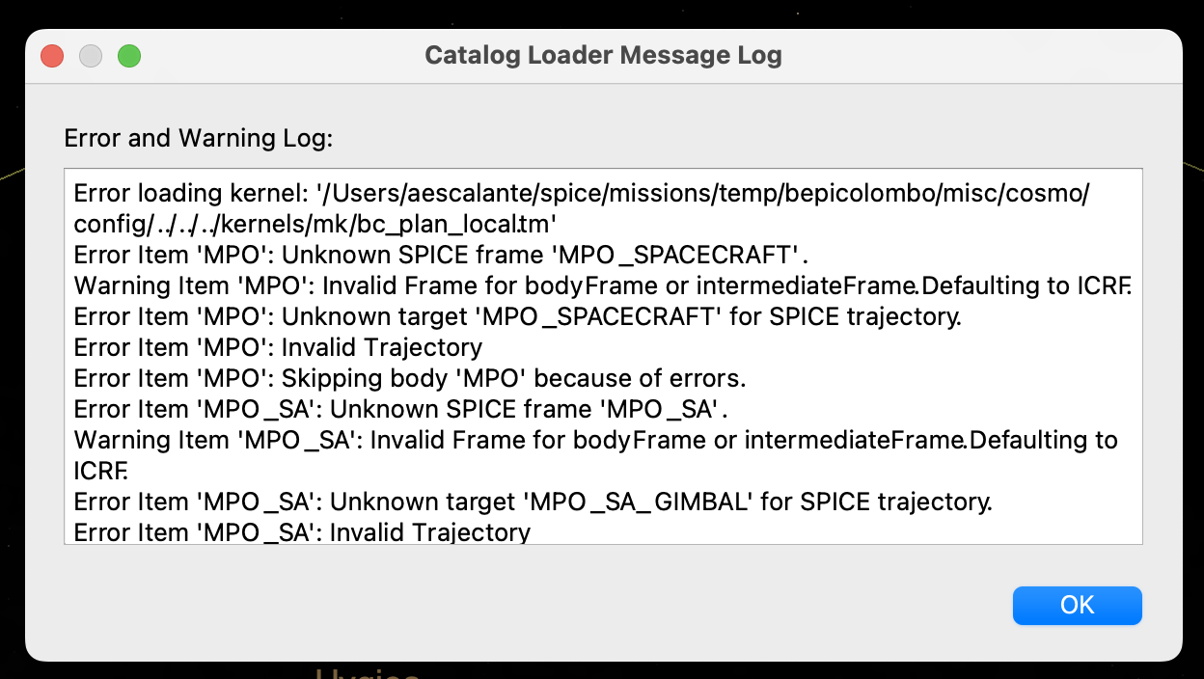
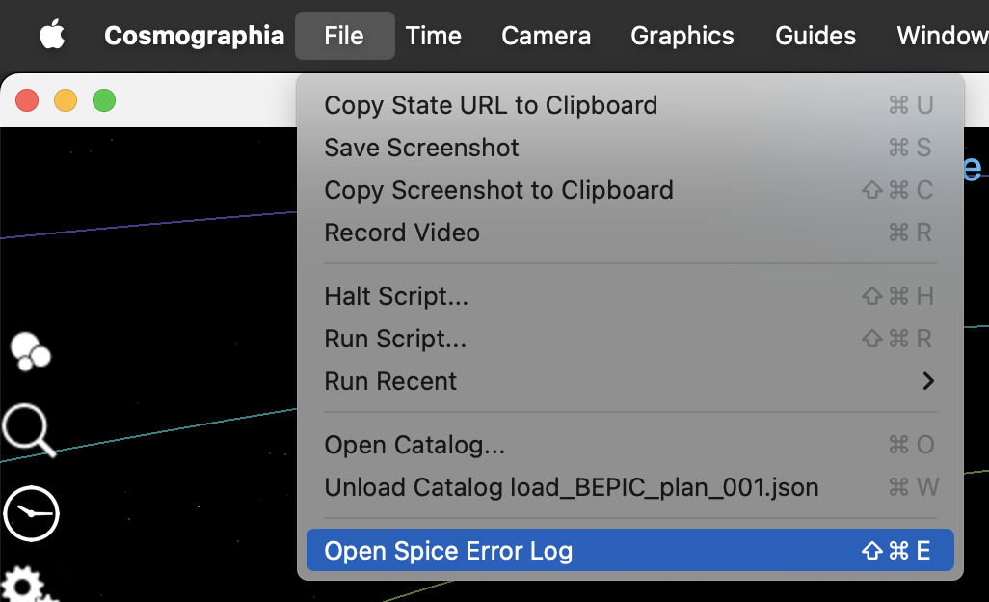
Loading the mission scenario
If the meta-kernel was not properly configured, you will get an error like:
                Make sure that the meta-kernel *_local.tm exists and the PATH_VALUES are properly set.
                If it is properly set and still get an error, you can check the Spice Error Log
In addition, to check that the meta-kernel is properly set it is properly set, you can use BRIEF utility to make sure it is working. It is included in the meta-kernel but can also be downloaded from:
  https://naif.jpl.nasa.gov/naif/utilities.html
>> brief kernels/mk/bc_plan_local.tm

Slide 21


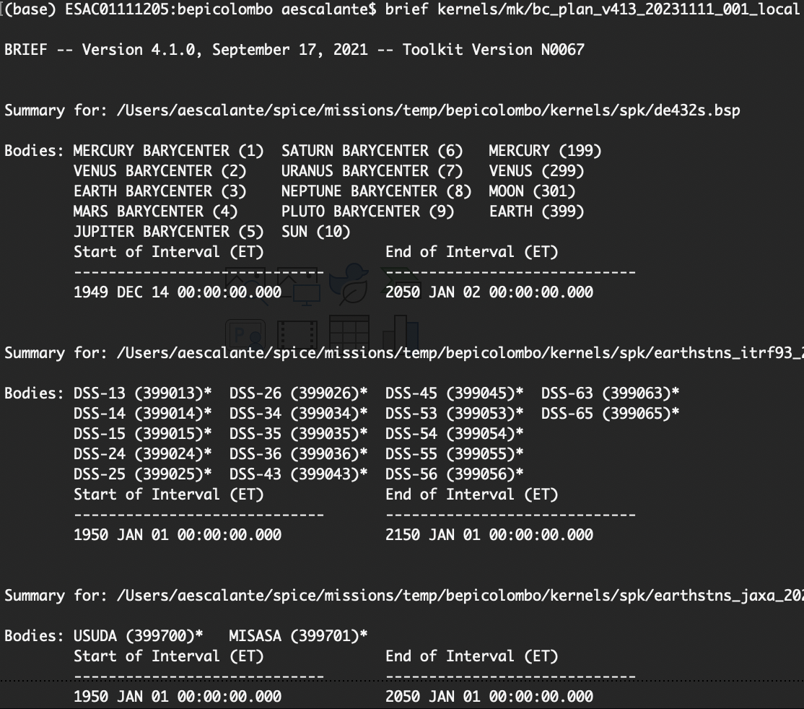
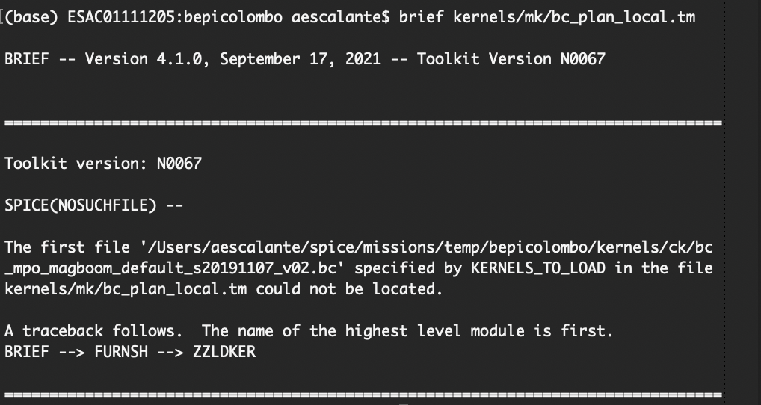
Loading the mission scenario

Slide 22
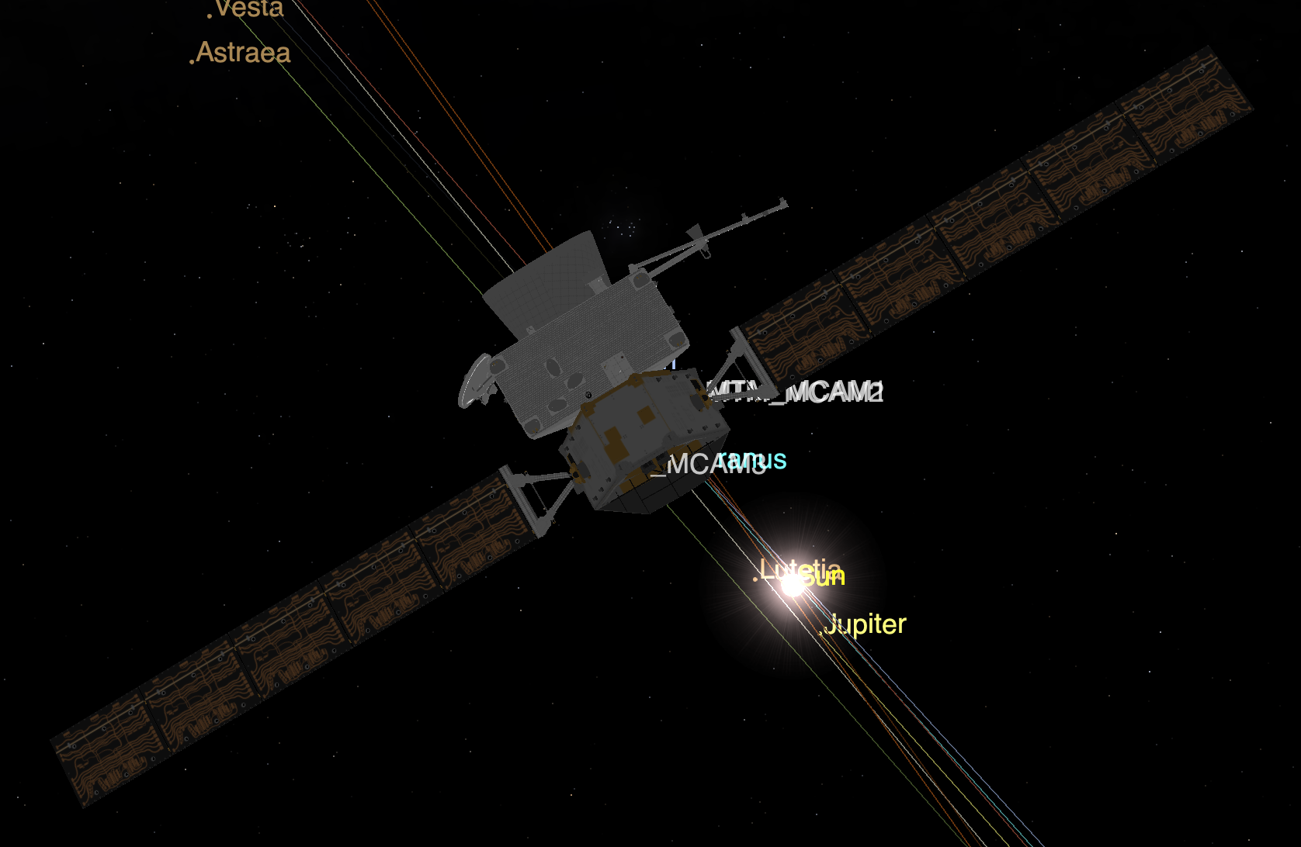
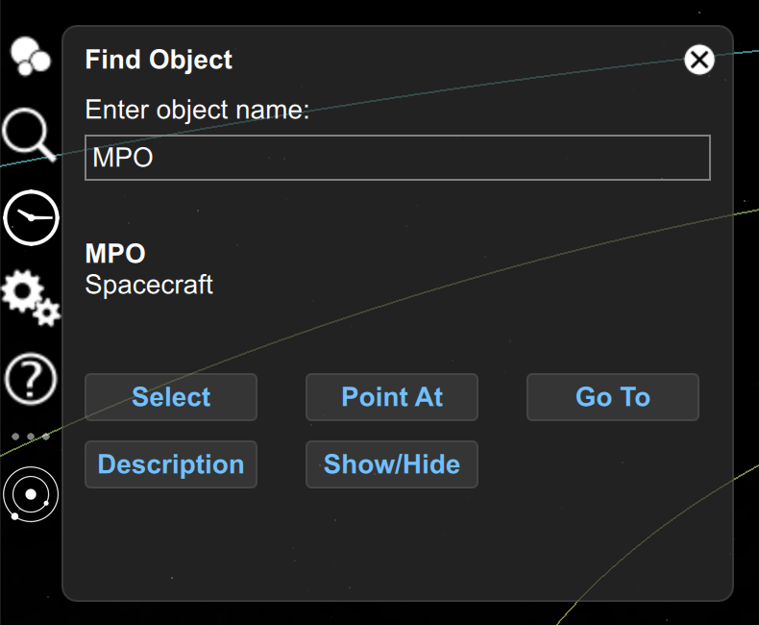
Loading the mission scenario
If everything was fine, you should now see your mission in Cosmographia:

Slide 23
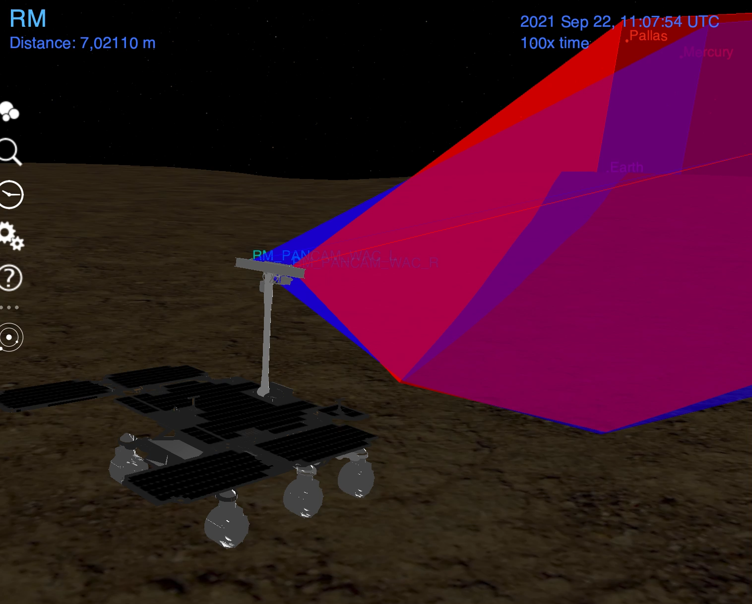
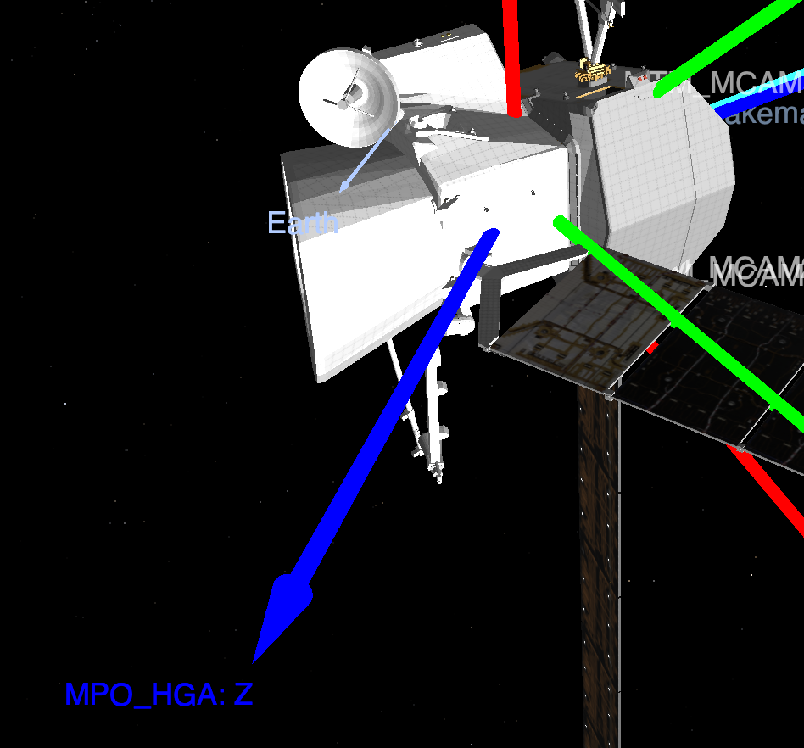
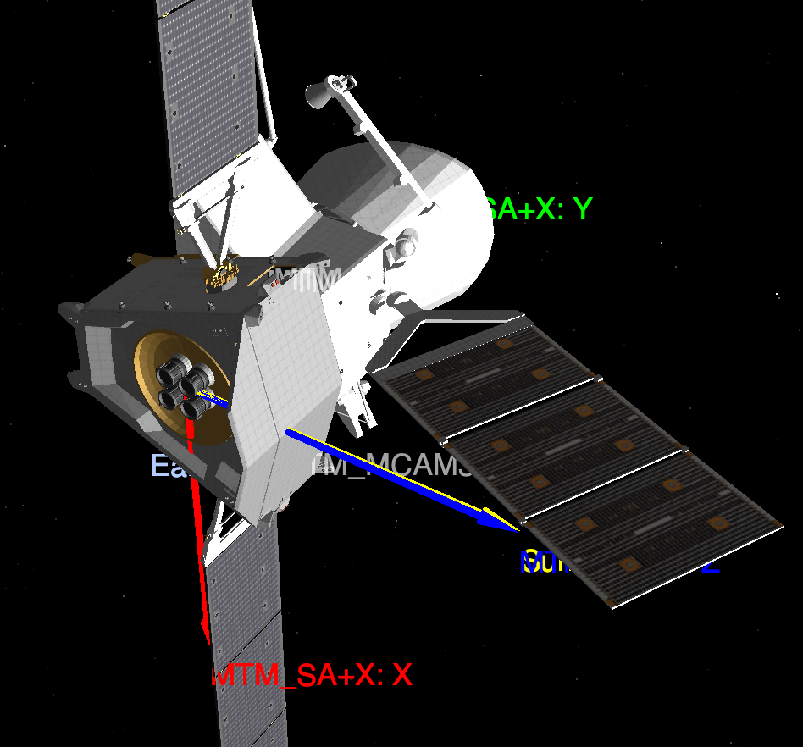
Visualizing the spacecraft
For some missions, we only have a single (fixed) model of the spacecraft, so you would not see the Solar Arrays or Antenna rotating.
However, you can display the Solar Arrays reference frames based on telemetry data and see how that fits the Sun Direction.
For missions with a full model composed of different parts you may see the movement in Cosmographia.

Slide 24
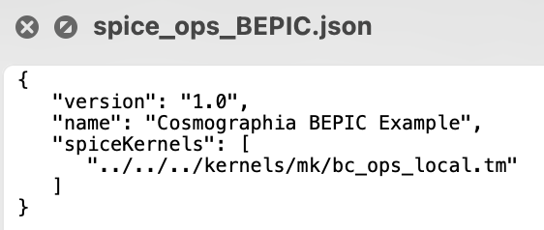
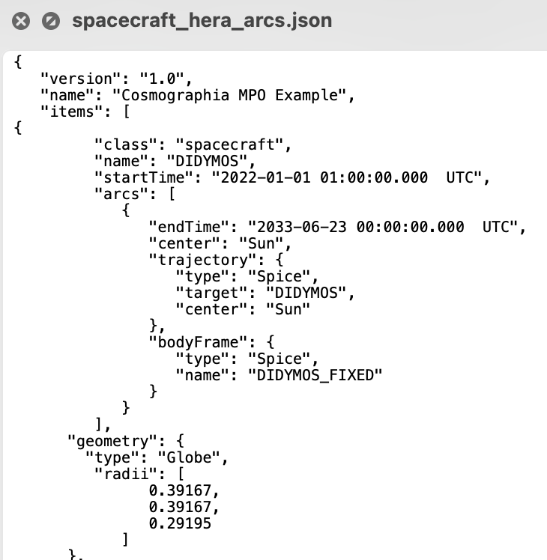
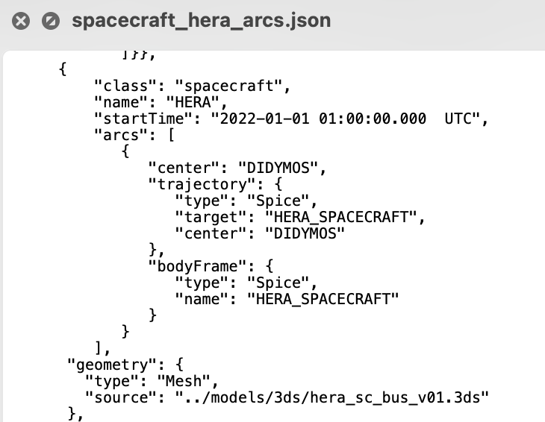
Catalog Configuration Files
The scenario catalog file we have loaded points to a predifined set of catalog files loading the SPICE kernels and defining the spacecraft, but there are more catalog files that can be loaded.
Under misc/cosmo/config we have the base catalogs to load:
  spice_{mk_reference}*.json catalogs, to load the SPICE kernels
  spacecraft_{missions}*_arcs.json catalogs define the bodies in the scene.

Slide 25
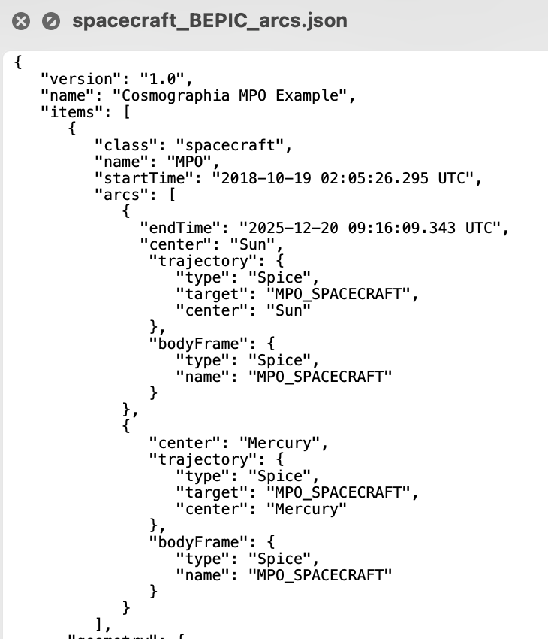
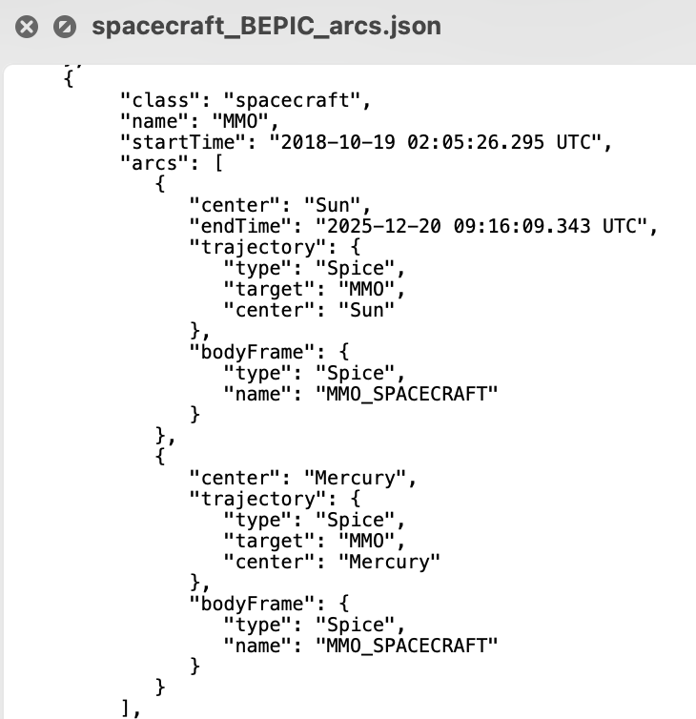
Spacecraft Catalog Files
We can have multiple arcs with different centers for the same body and multiple bodies in the same file.

Slide 26
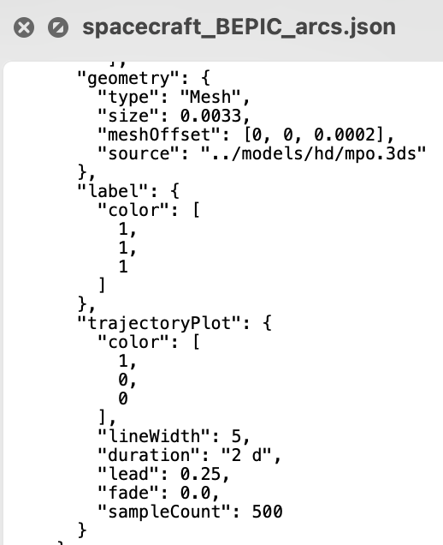
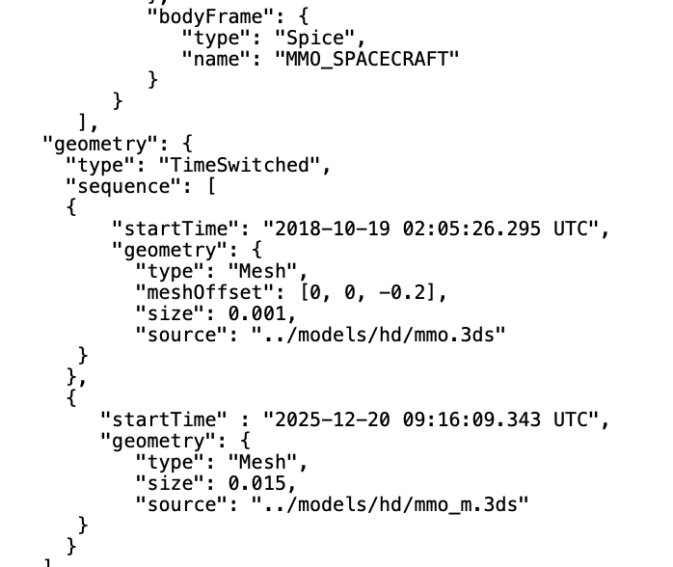
Spacecraft Catalog Files
Object label and trajectory visual aspect can be configured
Time Switched geometry for MMO before and after appendix deployment

Slide 27
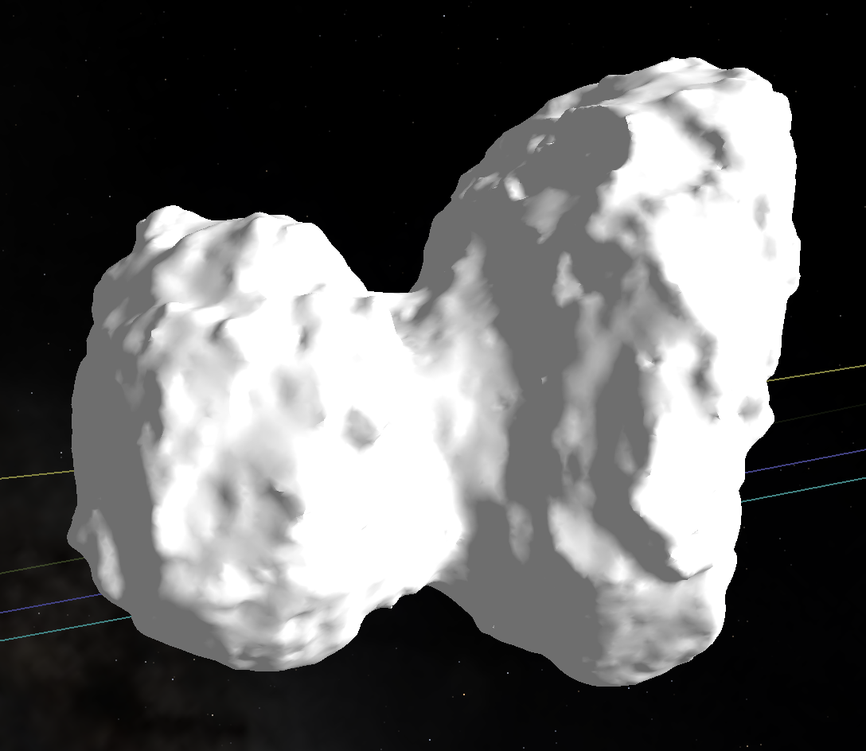
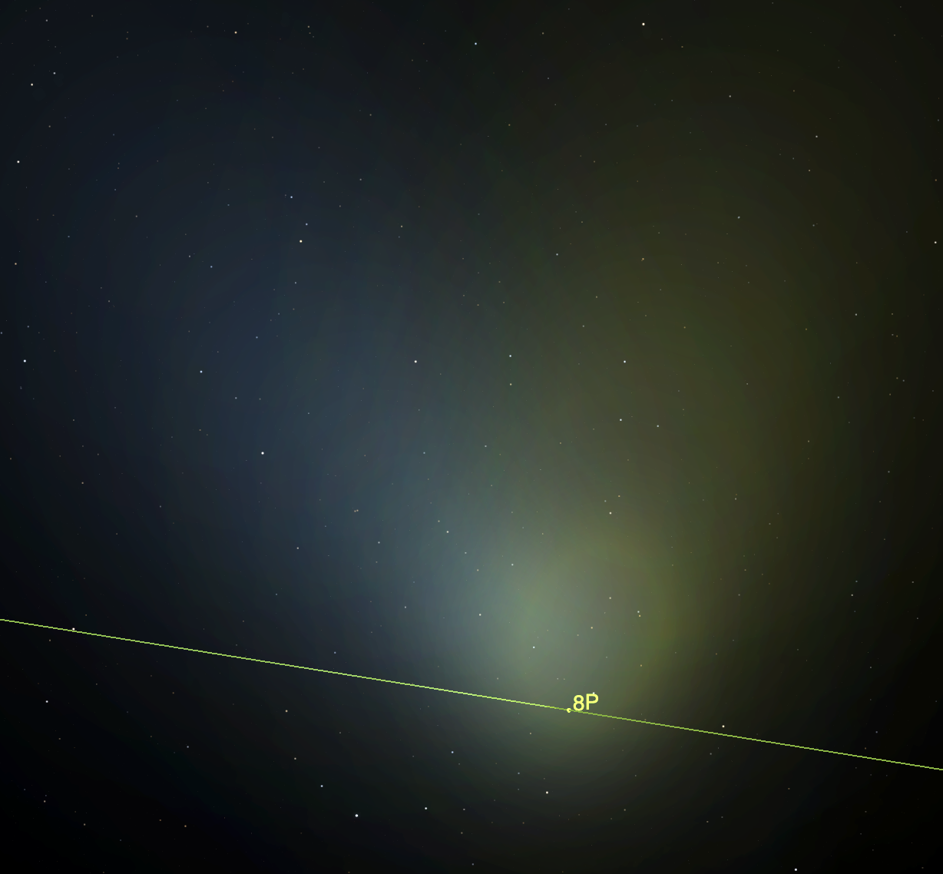
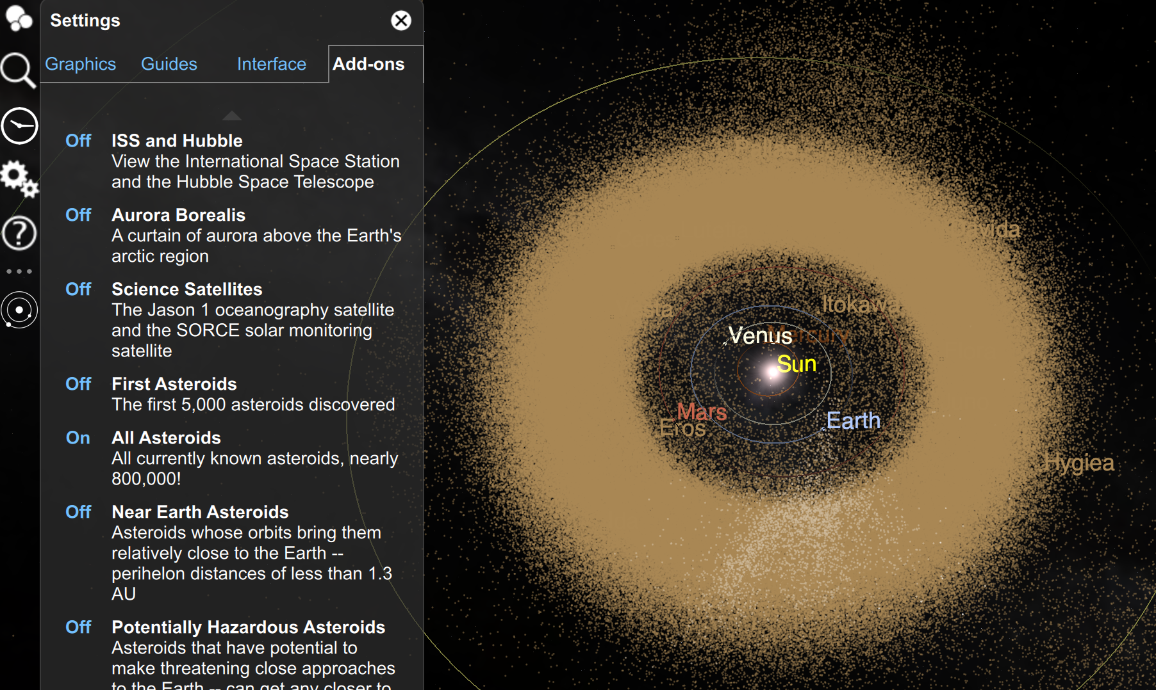
Spacecraft Catalog Files
In these files we define:
  The body target and center (observer) and body fixed frame
  The body geometry: Mesh/DSK, Globe, Ring, Particle System, Keplerian Swarm, Time Switched
    Scale and Offset
  Label and Trajectory plot options.

Slide 28
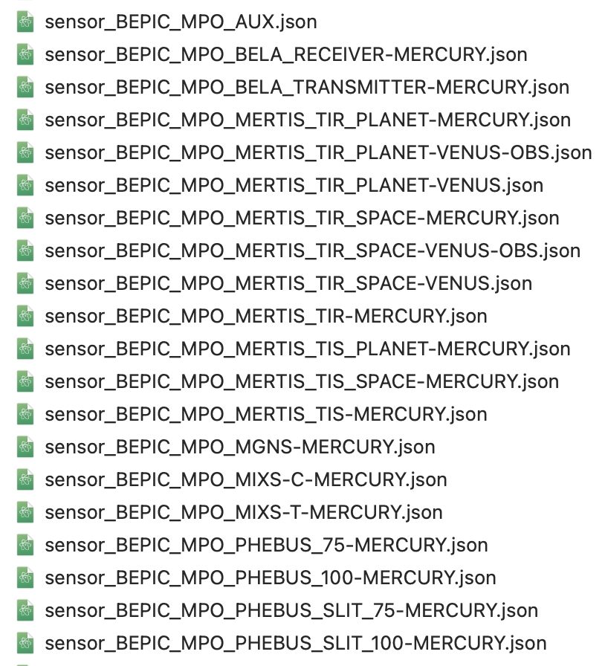
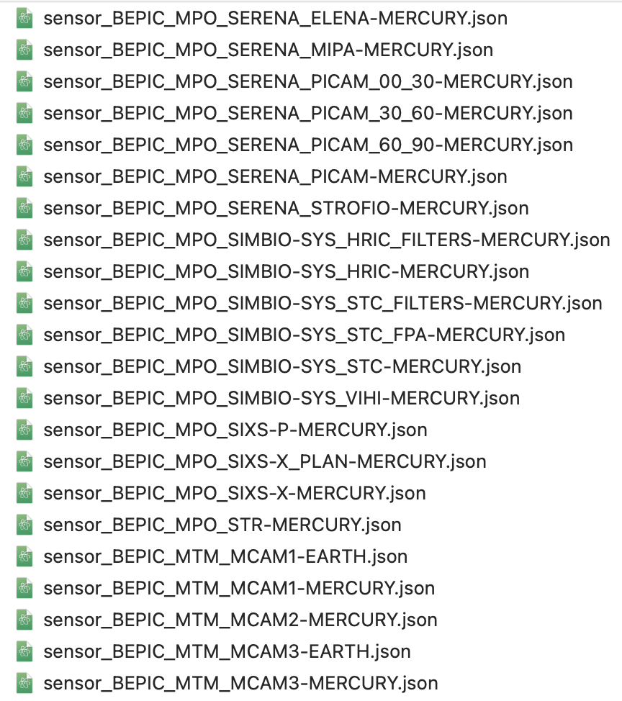
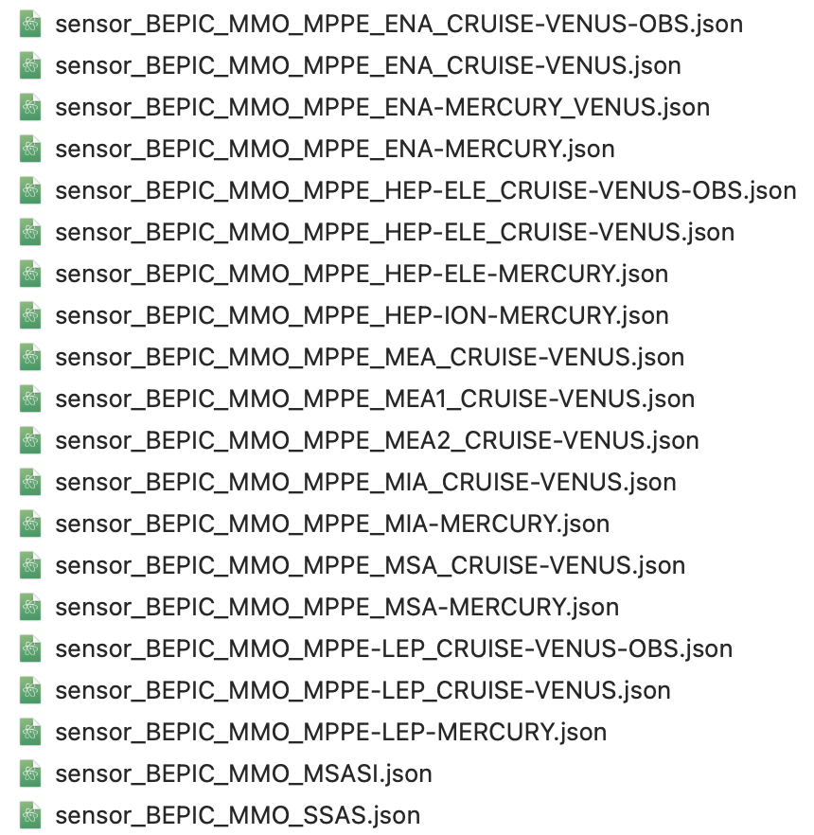
Sensor Catalog Files
For every sensor defined in the Instrument Kernels, there is a corresponding sensor catalog file under:
  misc/cosmo/sensors if anything is missing, let us know!

Slide 29
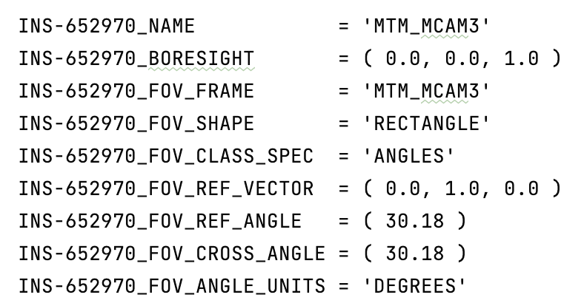
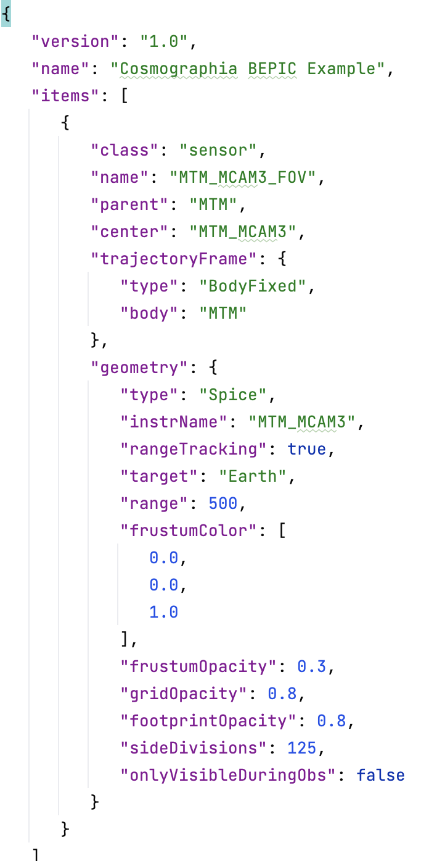
Sensor Catalog Files
It is possible to visualize the Field-of-view of the instruments defined in the Instrument Kernels (IK) of the SPICE Kernel Dataset
bc_mtm_mcam_v05.ti
sensor_BEPIC_MTM_MCAM3-EARTH.json

Slide 30
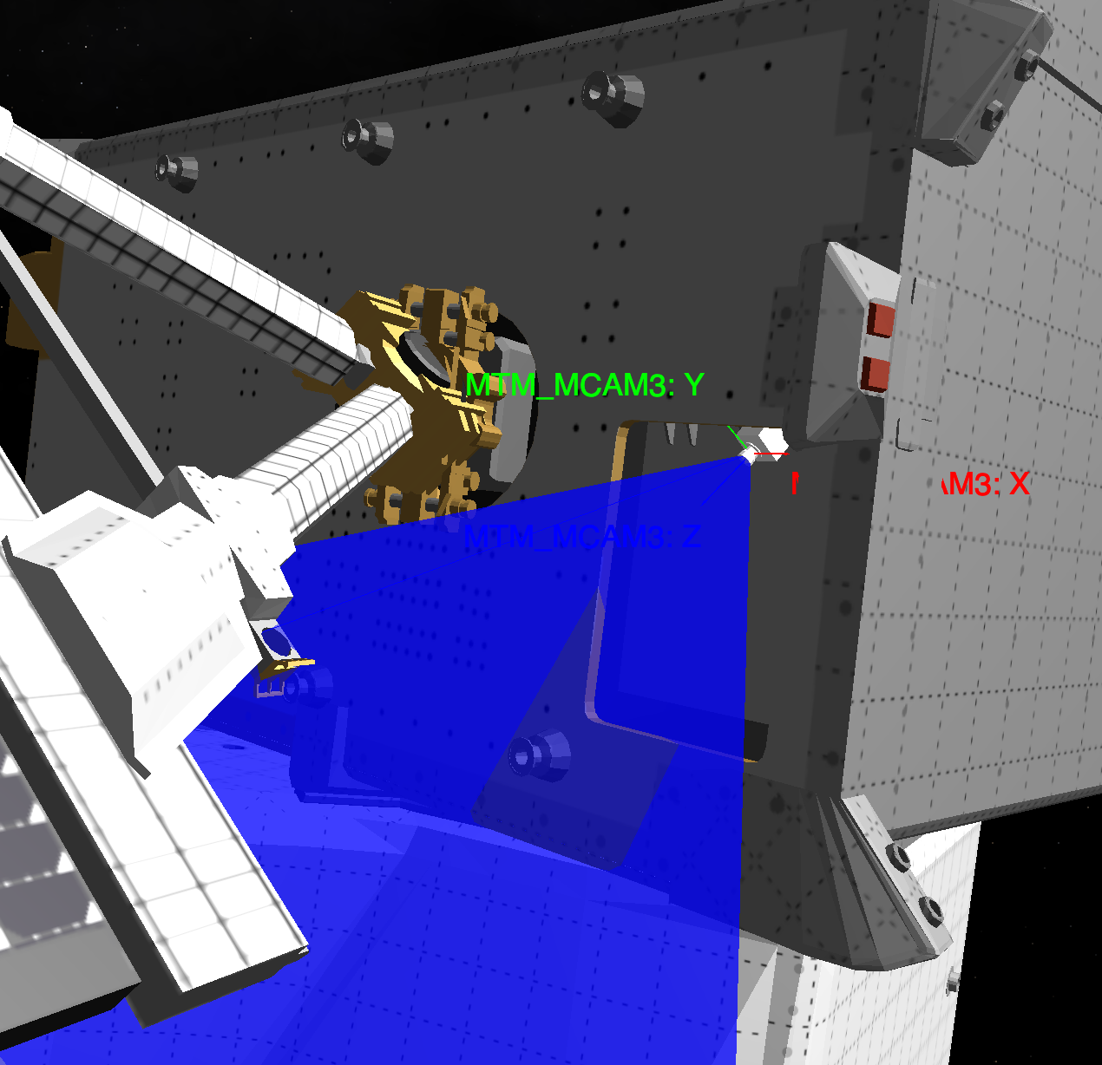
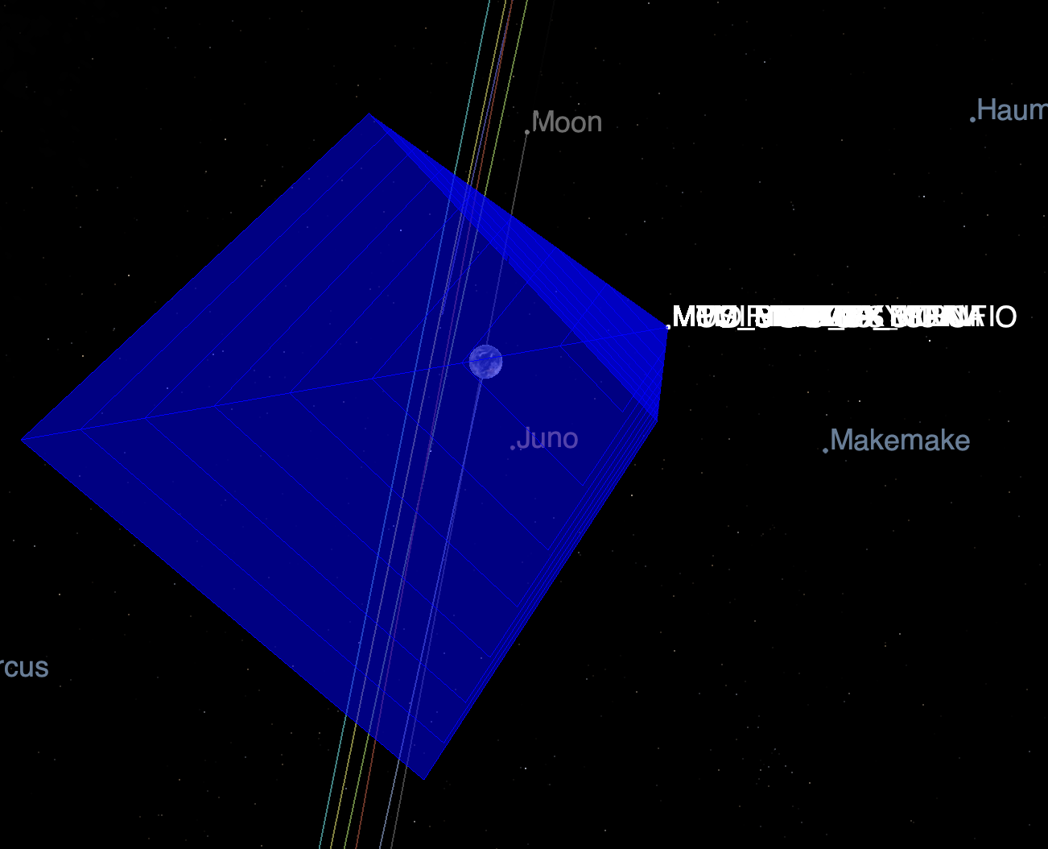
Sensor Catalog Files

Slide 31
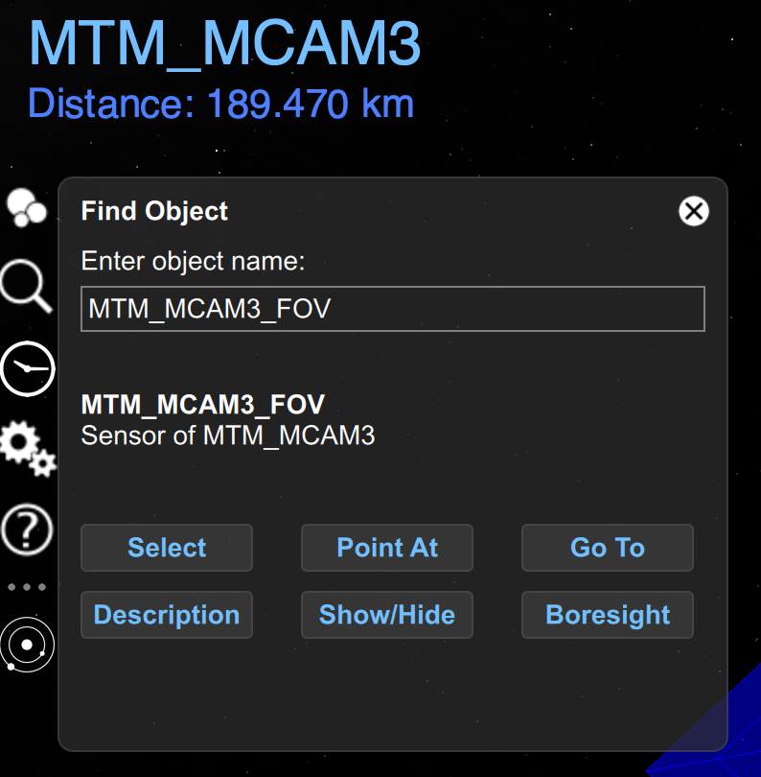
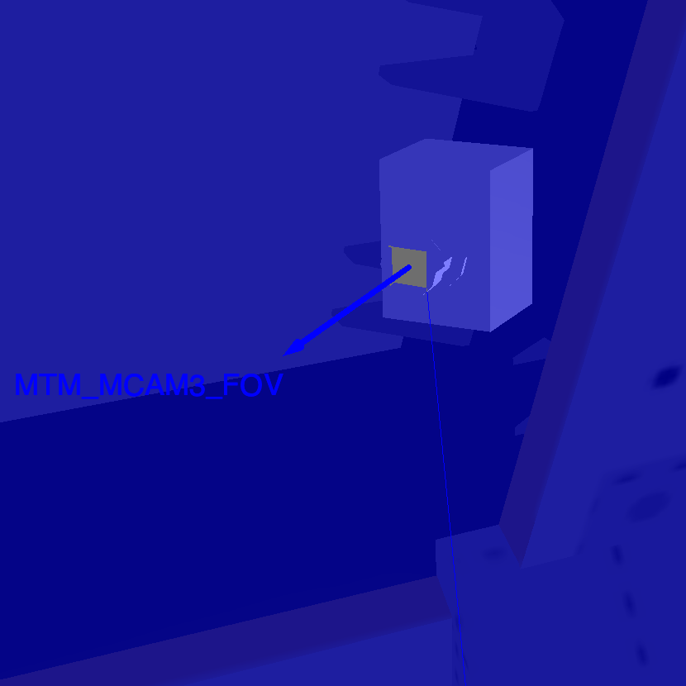
Sensor Catalog Files
It is possible to display the boresight of the loaded sensor by typing its name in the Find Object menu

Slide 32
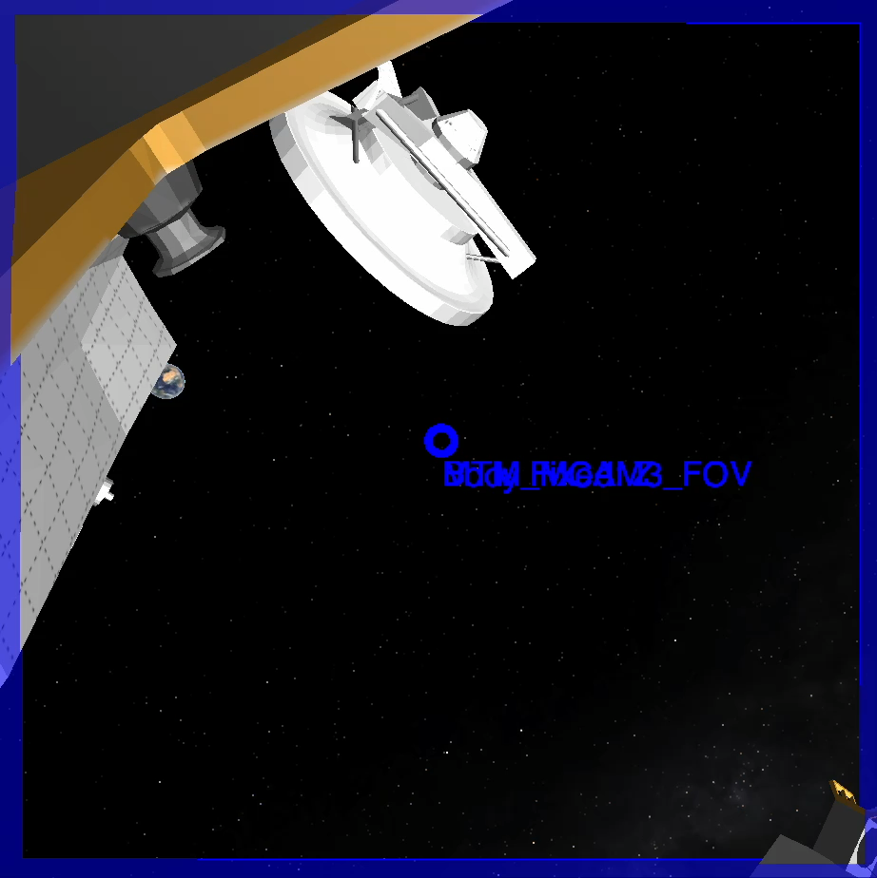
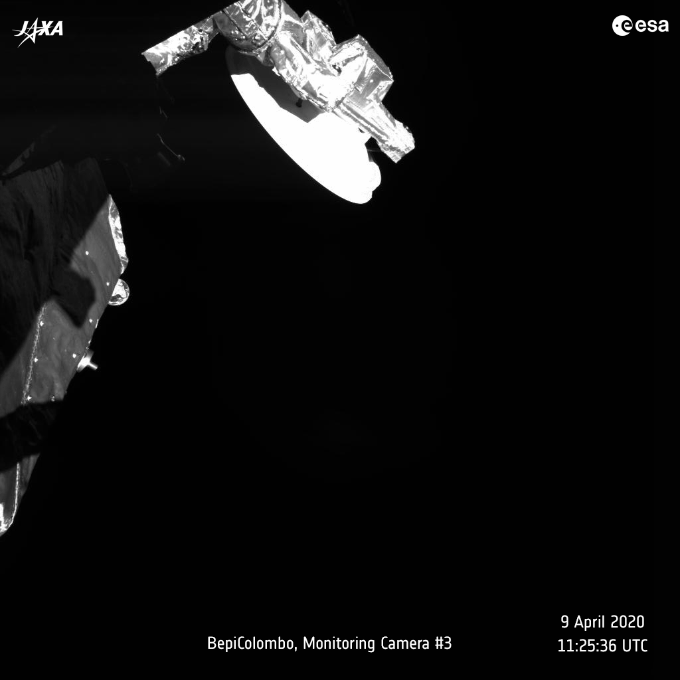
Sensor Catalog Files

Slide 33
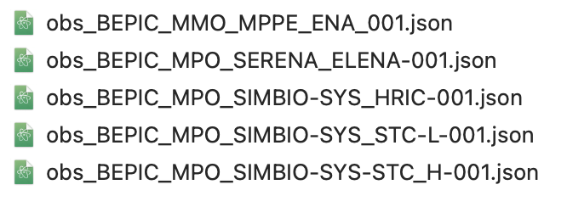
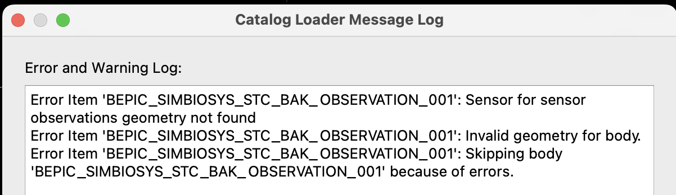
Observation Catalog Files
Once a sensor catalog has been loaded, the instrument is defined in the Cosmographia scene.
It is possible now to visualize the footprint of the instrument on a given target with the observation catalog
These are located under:
  misc/cosmo/observations
If there is a one-to-one correspondance between sensor catalog and instrument sensor, there may be multiple observation catalogs for a given instrument, each of them for different use cases.
NOTE: remember to always load the sensor catalog before the observation catalog, otherwise you will get an error

Slide 34
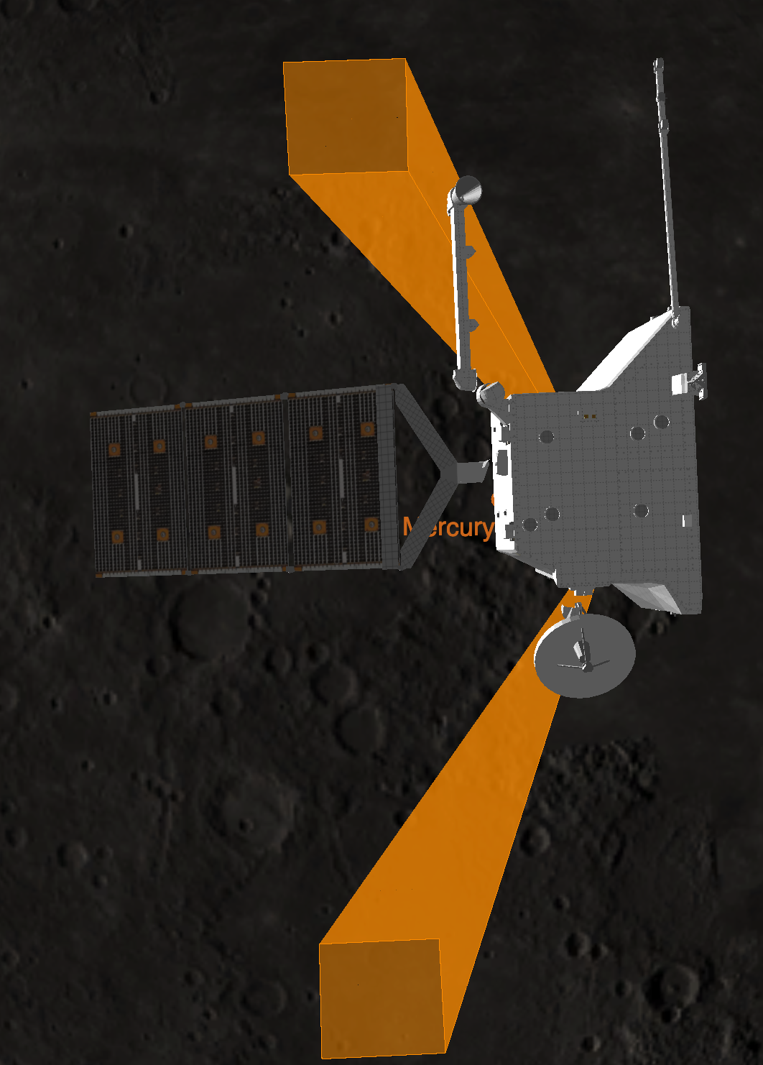
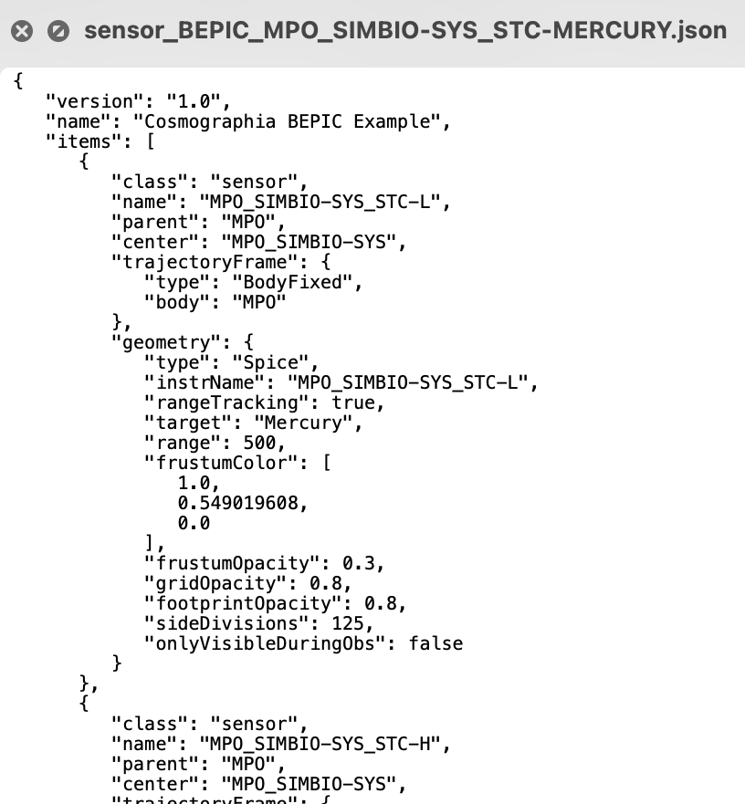

Observation Catalog Files

Slide 35


Observation Catalog Files

Slide 36


Shape Models and DSKs
For some missions, there are shape models avaialable different than the loaded by default.
In some cases the models are quite heavy or intended for a specific use case.
These are spacecraft catalog files and are available in:
  misc/cosmo/config

Slide 37


Shape Models and DSKs

Slide 38

Summary
The SPICE Kernels and Cosmographia configuration for a given mission are distributed together from BitBucket and our operational FTP/HTTPS
To load the mission scenario into Cosmographia:
  Create local copy of the meta-kernel: mv kernels/mk/bc_plan.tm kernels/mk/bc_plan_local.tm
  Update the PATH_VALUES in the local meta-kernel with the absolute path to your kernels directory
    PATH_VALUES = ( '/Users/aescalante/spice/missions/bc/bepicolombo/kernels’ )
  OR, install the amazing git hook so you do not have to worry every time you do a git pull
    cd [SKD_PATH]
    misc\git_hooks\skd_post_merge\install_hook_windows.bat (.sh for Mac and Linux)
The most important catalog to load is the scenario catalog for the meta-kernel you want
  spacecraft catalog and spice catalog are under config directory
  sensor catalogs load the field-of-view of IK defined instruments
  observation catalogs plot the footprint of sensors
  models directory contains 3D models and textures of objects

Slide 39


Cosmographia Scripting
Cosmographia allows the execution of Python scripts to automate some processes.
  Python 2 for Mac and Linux – Cosmographia 4.1 (or previous versions)
  Python 3 for Windows, Mac and Linux – Cosmographia 4.2 (or newer)

Slide 40
JUICE Cosmographia Plugin
The Cosmographia JUICE plugin is a software that adds extra features to the Cosmographia tool allowing an easy 3D visualisation of the JUICE spacecraft manoeuvres and instrument pointing.
The package deals with the tedious build-up of Cosmographia catalogue files, hiding the low-level details and providing a turn-key solution for quick and easy visualization of JUICE pointing
  Creation of complete Cosmographia scenes.
  Automatic SPICE Kernel setup based on metakernels.
  JUICE Spacecraft 3D Models integrated.
  Sensor and observation configuration.
  Load individual CKs
https://www.cosmos.esa.int/web/juice/cosmographia-plugin

Slide 41



Scene loading based on metakernels
The JUICE plugin deals with the preparation of the catalogues and spice configuration. The user selects a valid JUICE metakernel and the scene is prepared.
After the scene loading, the kernel set can be updated adding new attitude kernels

Slide 42


Sensors
The JUICE plugin helps with the preparation of the sensor catalogues, creating them on the fly.
After loading, a dedicated UI allows to identify and activate/deactivate them … and even have a quick look through them

Slide 43


Minor moons and Science models
Accessing and visualising the Jupiter minor moons is a tedious manual process in Cosmographia
Family colour and moon naming conventions
UI show/hide feature
Individual or family selection

Slide 44


Jupiter Rings
The Jupiter rings are implemented as a first order approximation mainly for science planning purposes (Pointing Design, Occultation opportunities, etc.). The rings are implemented in JUICE Cosmographia Plugin, the Cosmographia configuration files of the SPICE Kernel data set, the SPICE kernels themselves and in the JUICE Pointing Tool.

Slide 45


Io and Europa Torii
The Jupiter and Europa Tori are implemented in the JUICE SPICE kernels, the plugin, and the Cosmographia configuration for science planning activities.
The Io Plasma Torus (IPT) is based on a 2-D model representing a section of the Io Torus based on data from the JUNO mission.
For the Europa Plasma Torus (EPT) The torus is centered on 10.5 RJ (not centred in moon) with an ellipsoidal radius of 1.5 RJ in-plane and 1 RJ out of the plane, where the plane is defined by Europa’s orbital plane around Jupiter.

Slide 46



Jupiter Main Aurora and Magnetosphere belts
The Jupiter Main Aurora and Inner, Middle, and Outer Magnetosphere belts are available in the plugin and in the Cosmographia configuration files of the SPICE kernel set for visualization purposes and they show the magnetosphere of Jupiter and aurora. The magnetosphere is generated through the particle system option of Cosmographia, with particle positions along magnetic field lines estimated by a model. The aurora position also uses the particle system, with locations obtained from the Auroral Ovals files provided by LASP/University of Colorado

Slide 47


Online help
Big thanks to Marc Costa
https://juicesoc.esac.esa.int/help/cosmog/

Slide 48

The backdoor - Getting access to the main window
In the previous section of Cosmographia scripting, we have seen how to execute a Cosmo script and what is the intended flow of the scripting.
With the plugin we wanted a way of interacting with Cosmographia out of this loop. So, we searched for a method of bypassing normal processing and allow us to extend the capabilities.
After analysing the tool and its usage of the Qt framework (pyQt 5), we concluded, that getting access to the main window, and setting up a ‘hook’ on it (as a menu option for example)

Slide 49



The backdoor – creating an app on top
Adding custom packages to the cosmo scripting (Cosmographia 4.1+)
PyQT and Qcreator (UI development)

Slide 50



Next Generation
Limitations for the development have been removed with Cosmographia 4.2
The experience gained during the juice plugin allows us to extend the capabilites and improve the mission specific usability
Refactoring is needed to ensure the maintenability and stability
SPICE service is open to implement or support mission specific use cases that can benefit from the Cosmographia capabilities.

Slide 51
Open Discussion
Thank you very much for following the Cosmographia Training!
We hope you will now know how to load your missions scenario into Cosmographia, plot reference frames, instruments field-of-views and observations.
Learn more at the official Cosmographia User Guide: https://cosmoguide.org/
QUESTIONS?

