Slide 1
Non-Toolkit Applications
April 2012

Slide 2
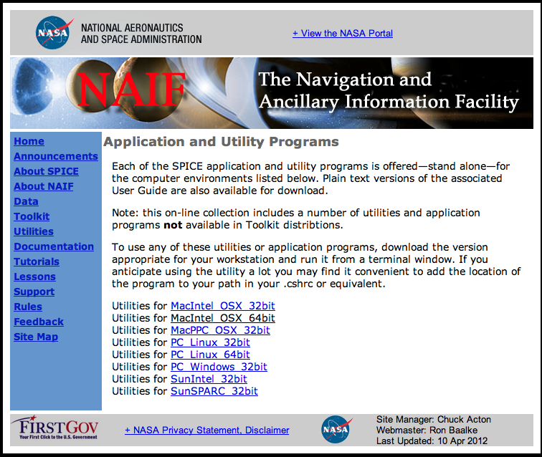
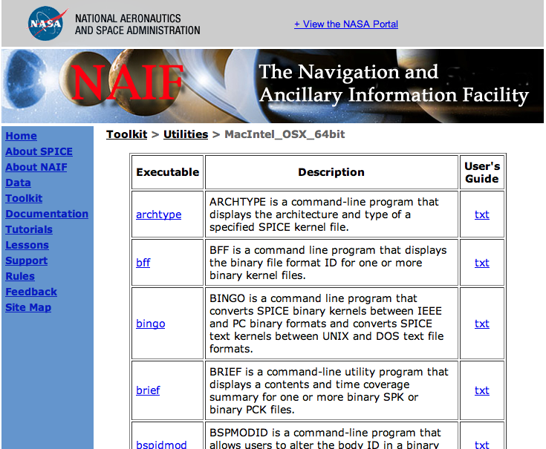
Location of Utilities and Documentation
Download utilities and documentation from the NAIF Website

Slide 3
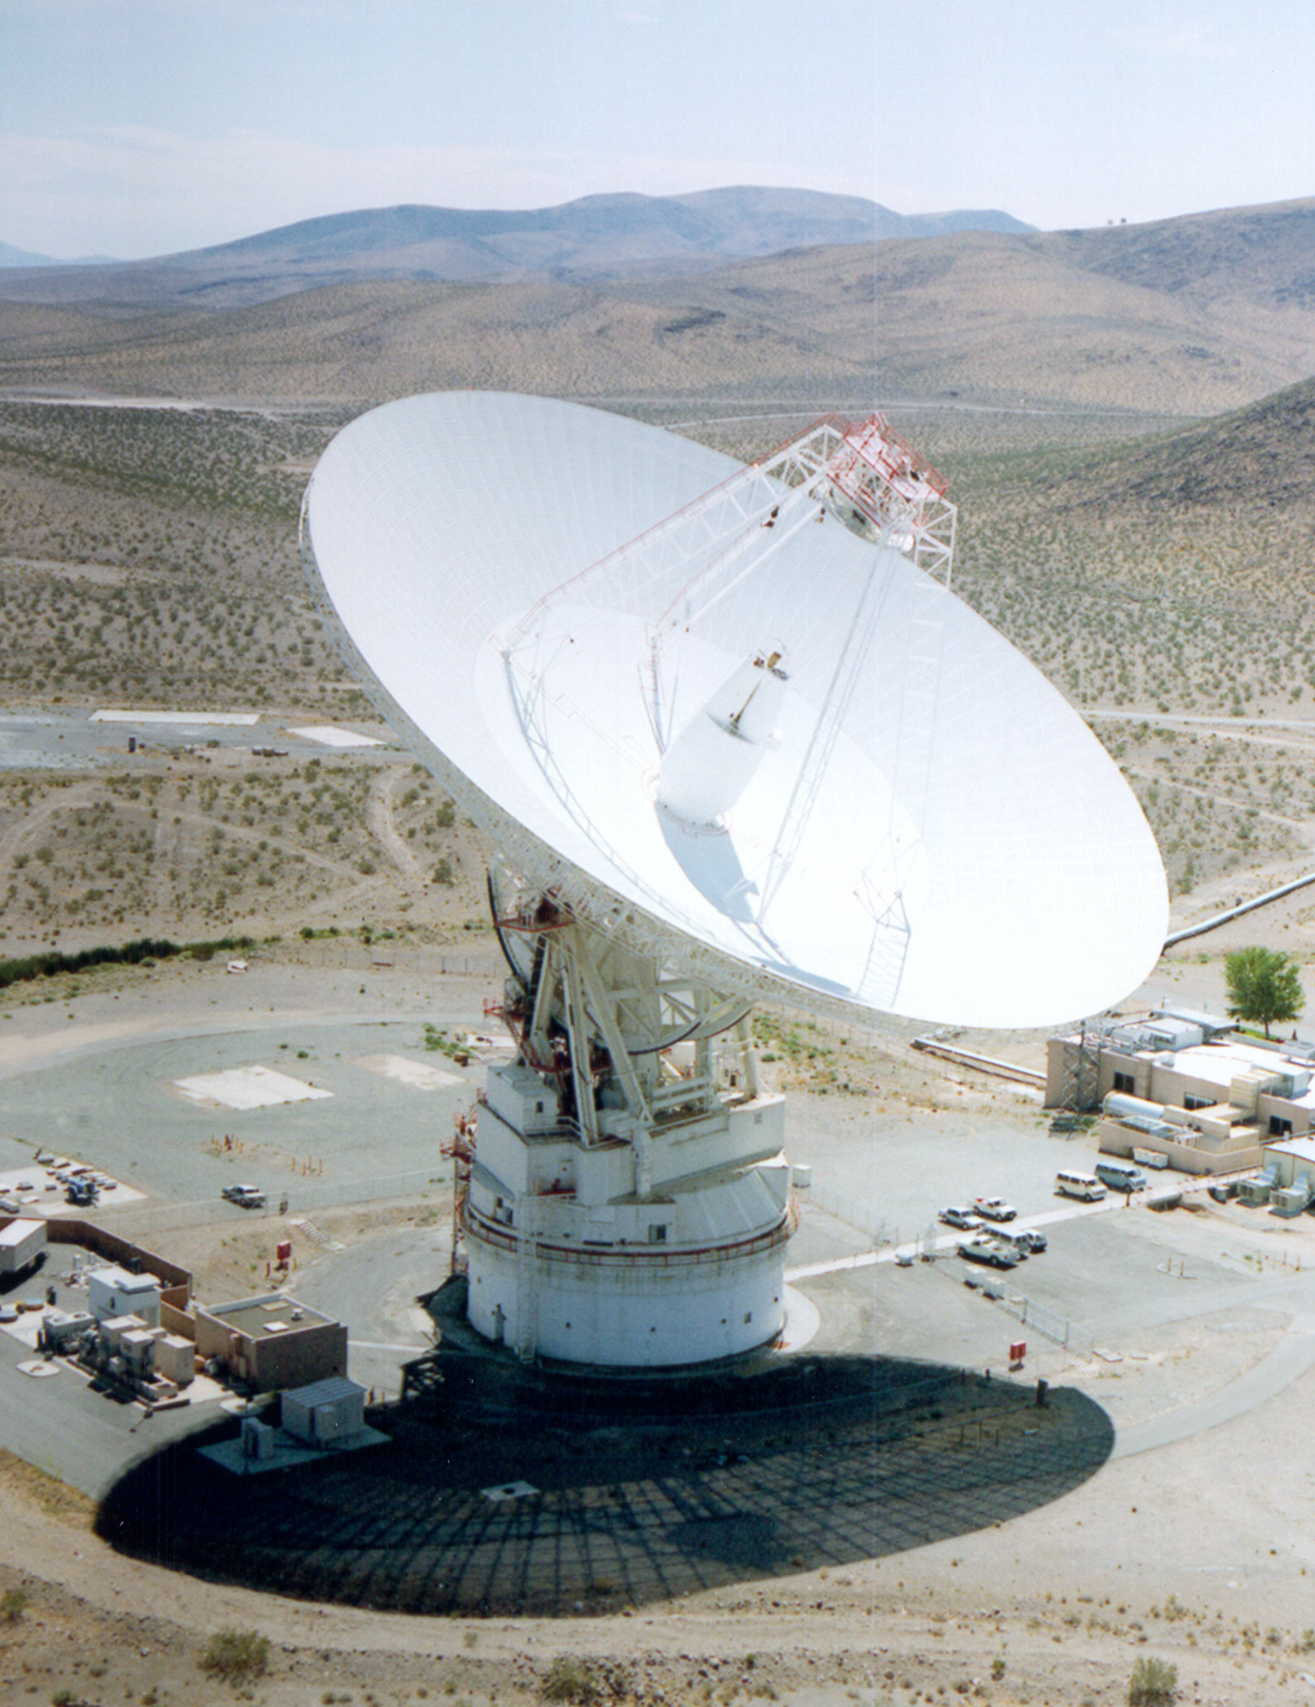
Make Slow-Moving SPKs and FKs
PinPoint creates files for objects with fixed or slowly changing positions with respect to another object.
Creates:
SPK (position and velocity ephemeris)
Topocentric FK frames kernels
Applications:
Ground stations
Landing sites
Sites along a rover’s path
Coming soon:
Constant velocity routines in SPICE
Notes:
DSN picture from: http://deepspace.jpl.nasa.gov/dsn/gallery/images/goldstone3.jpg

Slide 4
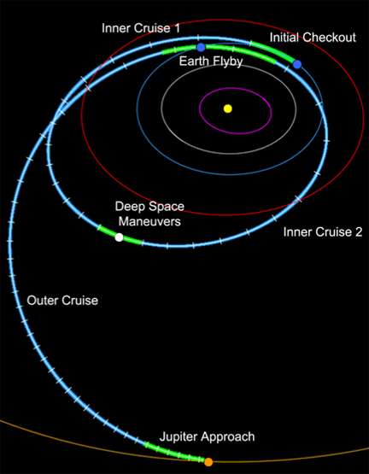
View SPKs
Spy is used to validate, inspect, and analyze SPK (position, velocity ephemeris) files.
View contents of an SPK file
Data
Summary
Comments
Sample data
Position, distance, velocity, speed, acceleration, etc.
Check SPK files
Validate the structure of an SPK
Locate invalid double precision numbers
Check for boundary violations
Find geometric events
Observer ➔ target distance
Target elevation
Notes:
Trajectory picture: http://www.cbsnews.com/network/news/space/pictures/juno/juno_orbit.jpg and http://www.nasa.gov/images/content/575571main_Juno20110727-3-43_946-710.jpg

Slide 5
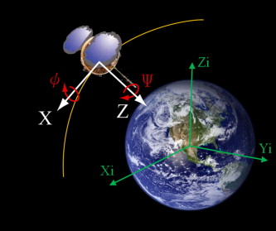
Make Simple CKs
prediCkt makes CK (orientation, attitude) files for objects with orientations that can be described with simple geometry.
Point at the Sun
Point at the Earth
30 degrees away from the Sun in a certain direction
Nadir direction
More information: Making a CK file tutorial
Notes:
Picture from: http://ars.sciencedirect.com/content/image/1-s2.0-S0273117712001068-gr1.jpg

Slide 6
CK Slicer
CkSlicer reduces a CK file to a shorter interval of time.
Applications:
If a small time interval of the CK file is needed and the CK file is very large.
If you need to merge CKs from different sources that have too much overlap.
Original CK Coverage
CK Coverage after CkSlicer
Time
Notes:
CkSlicer graphic made by Sam Krening.

Slide 7
Fill in Gaps Between CK Segments
CKsMrg fills in gaps between multiple CK segments
Used for CKs from the same data stream
Daily CKs created from downlinked telemetry
Don’t use on CKs from multiple data streams
Reconstructed and predicted
Can make a CK smaller by down sampling
Original CK: 3 segments
S1
S2
S3
CK after CKsMrg:
1 segment
Time
Notes:
CKsMrg graphic made by Sam Krening.

Slide 8
Fill in CK Segment Gaps
CkSpanIt fills in gaps within segments in a Type 3 CK file
Changes the interpolation intervals that used a small tolerance in the original CK file
Account for telemetry dropouts
CkSpanIt converts CKs to different SPICE formats
From Type 1 to Type 3
From Type 1 to Type 2
From Type 3 to Type 2
Original CK Segment with Gaps
Modified CK Segment after CkSpanIt
Time
Notes:
CkSpanIt graphic made by Sam Krening

Slide 9
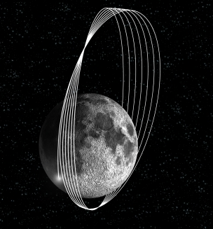
Orbit Number
OrbNum calculates the:
Orbit number
Apoapse, periapse, descending or ascending node
Start and Stop times of the orbit
Can calculate more information at the start of each orbit
Latitude and longitude of surface point closest to the spacecraft
Sub-solar latitude and longitude
Altitude of spacecraft
Distance to Sun
Keplerian orbital elements
Notes:
Orbit picture from: http://sci.esa.int/science-e-media/img/10/orbtis410.jpg

Slide 10
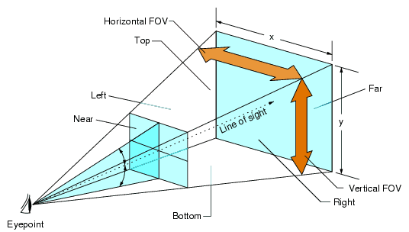
Field of View
Optiks shows information about each instrument’s field of view from instrument and frames kernels (IKs and FKs)
Shape
Rectangular
Elliptical
Circular
Polygonal
Boresight
Notes:
FOV image from: http://codinghorror.typepad.com/.a/6a0120a85dcdae970b0120a86d9495970b-pi

Slide 11
Join Binary DAF Files
DafCat concatenates (joins) binary DAF files
SPKs, CKs, binary PCKs
We recommend using SpkMerge for merging SPKs
DAF 1
DAF 2
New DAF file after DafCat

Slide 12
Replace IDs
DafMod alters IDs in binary SPK, CK, or PCK files.
Can modify:
Target, center, or reference frame ID in an SPK
Object or reference frame ID in a CK or PCK
Applications
Create simulation spacecraft
Compare two trajectories for the same object in one program
BSpIdMod modifies the object IDs in a binary SPK file
Less powerful version of DafMod.
DAF File before DafMod
Information
Object: -41
More information…
DAF File after DafMod
Information
Object: -123456
More information…

Slide 13

Make SCLK Kernel
MakClk makes a spacecraft clock (SCLK) kernel from a SCLKSCET file.
A SCLKSCET file is a time correlation file used by most JPL missions
Contains information needed to make an SCLK kernel

Slide 14
More Utilities – File Formats
BFF - Binary File Format
BFF displays the binary file format of a SPICE kernel
BIG-IEEE
LTL-IEEE
Bingo – Converts files between formats
IEEE big endian ⬅➔ IEEE little endian
DOS ⬅➔ UNIX
ArchType - file architecture and type of a SPICE kernel
Architectures
DAF, DAS, KPL
Types
SPK, PCK, IK, CK, LSK, FK
Useful for scripts that need to identify SPICE kernels
Notes:
UNIX picture from: http://www.unix.org/
DOS picture from:

Slide 15
backup

Slide 16
PinPoint Example
Terminal Window
$ more mer1_meridiani.def
Sample PINPOINT input for MER-1 landing site coordinates.
\begindata
SITES = ( 'LS' )
LS_CENTER = 499
LS_FRAME = 'IAU_MARS'
LS_IDCODE = -253900
LS_XYZ = ( +3.3764222E+03 -3.2664876E+02 -1.1539218E+02 )
LS_BOUNDS = ( @2001-01-01-00:00:00.000, @2100-01-01-00:00:00.000 )
\begintext
$ pinpoint -def mer1_meridiani.def -spk mer1_meridiani.bsp
$ brief mer1_meridiani.bsp
Brief. Version: 2.2.0 (SPICE Toolkit N0057)
Summary for: mer1_meridiani.bsp
Body: -253900* w.r.t. MARS (499)
Start of Interval (ET) End of Interval (ET)
-------------------------------- --------------------------------
2001 JAN 01 00:00:00.000 2100 JAN 01 00:00:00.000

