Slide 1
Instrument Kernel IK
April 2012

Slide 2
What is an IK?
An Instrument Kernel (IK) is a text file that includes information about a spacecraft’s instruments.
Always includes
Field-of-view (FOV) information
Shape
Orientation
Size
Sometimes includes
Timing parameters
Calibration data
Y
X
Z
Boresight
Instrument
focal point

Slide 3
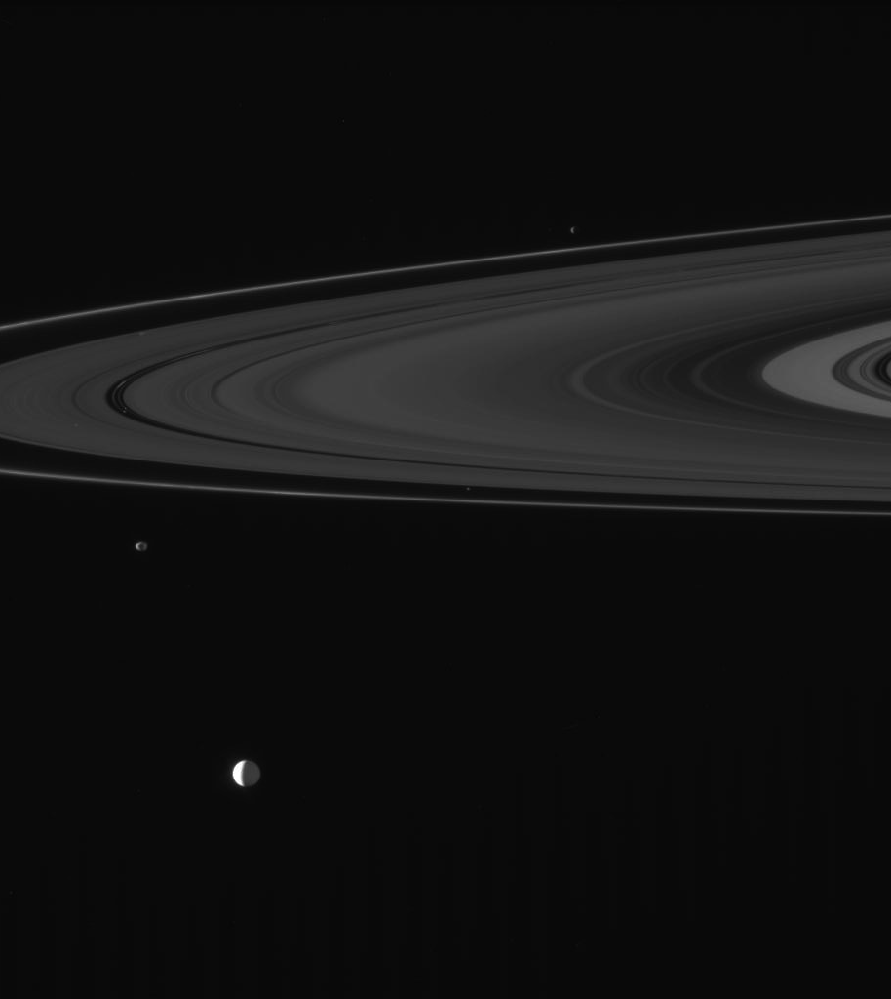
Field of View - Visibility
Cassini’s narrow angle camera took this picture.
Which of Saturn’s moons are in the picture?
Use GFTFOV (or FOVTRG) to find which targets are in the camera’s field of view.
Only works because the camera’s FOV is defined in an instrument kernel.
Result: There are 7 moons in this picture!
Enceladus, Janus, Epimetheus, Atlas, Pan, Daphnis, and Anthe
Notes:
Figure from PDS Image Node.

Slide 4
IK Structure
KPL/IK
ISS Instrument Kernel
=========================
This instrument kernel (I-kernel) contains references
to the mounting alignment, internal and FOV geometry
for the Cassini Imaging Science Subsystem (ISS) instruments.
. . .
Narrow Angle Camera (NAC):
\begindata
INS-82360_FOV_FRAME = 'CASSINI_ISS_NAC'
INS-82360_FOV_SHAPE = 'RECTANGLE'
INS-82360_BORESIGHT = (
0.0000000000000000 0.0000000000000000 +1.0000000000000000
)
INS-82360_FOV_CLASS_SPEC = 'ANGLES'
INS-82360_FOV_REF_VECTOR = (
+1.0000000000000000 0.0000000000000000 0.0000000000000000
)
INS-82360_FOV_REF_ANGLE = ( 0.175 )
INS-82360_FOV_CROSS_ANGLE = ( 0.175 )
INS-82360_FOV_ANGLE_UNITS = 'DEGREES'
\begintext
. . .
Tells SPICE this text file is an IK
Tells SPICE where the data are
Write A LOT of comments!
Include instrument data
Keyword = value
Format
INS#_KEYWORD

Slide 5
Circular Field of View
Basic Definition
Shape
Frame
Boresight
Option 1: Vectors
Boundary corner vector
One vector for a circular FOV
Option 2: Angles
Angle
Ref angle value
One angle for a circular FOV
Units
Reference vector
Y
Boundary Corner Vector
X
Boresight
Z
Ref
(0,0,0)
Instrument
focal point

Slide 6
Elliptical Field of View
Basic Definition
Shape
Frame
Boresight
Option 1: Vectors
Boundary corner vectors
Two vectors for an elliptical FOV
Option 2: Angles
Angle
Reference Angle
Cross Angle
Units
Reference vector
Y
Boundary Corner Vectors
Boresight
X
Z
Ref
(0,0,0)
Cross
Instrument
focal point

Slide 7
Rectangular Field of View
Y
Basic Definition
Shape
Frame
Boresight
Option 1: Vectors
Boundary corner vectors
Four vectors for a rectangular FOV
Option 2: Angles
Angle
Reference Angle
Cross Angle
Units
Reference vector
Boundary Corner Vectors
Z
X
Boresight
Instrument
focal point
Top View
Side View
X
Y
Cross
Ref
Boresight
Boresight
Z
Z

Slide 8
Polygonal Field of View
FOV Definition
Shape
Frame
Boresight
Boundary corner vectors
Y
Boundary Corner Vectors
X
Z
Boresight
Instrument
focal point

Slide 9
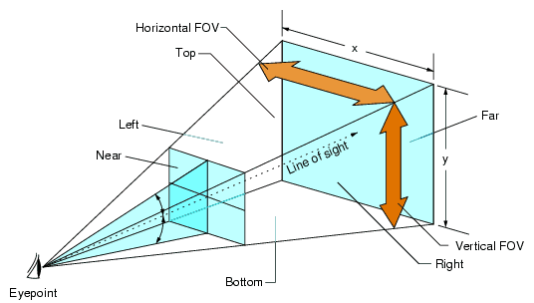
Field of View Utility
Optiks shows information about each instrument’s field of view from instrument and frames kernels (IKs and FKs)
Shape
Rectangular
Elliptical
Circular
Polygonal
Boresight
Download Optiks
NAIF Website
Notes:
FOV image from: http://codinghorror.typepad.com/.a/6a0120a85dcdae970b0120a86d9495970b-pi

Slide 10
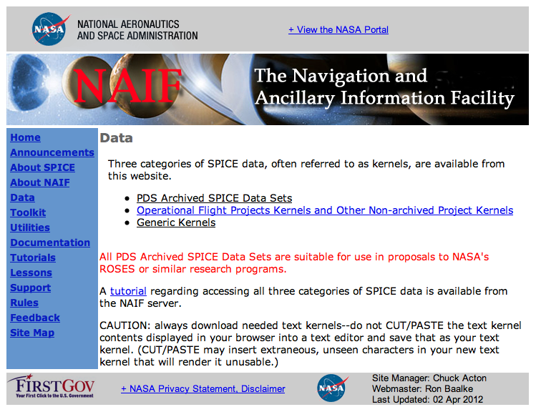
IK Examples – NAIF Website
Visit the NAIF website for examples of real mission IKs:
http://naif.jpl.nasa.gov/naif/data.html

Slide 11
More IK Resources
Documentation of GETFOV routine
http://naif.jpl.nasa.gov/pub/naif/toolkit_docs/FORTRAN/spicelib/getfov.html
Optiks User’s Guide
ftp://naif.jpl.nasa.gov/pub/naif/utilities/MacIntel_OSX_64bit/optiks.ug
NAIF IDs Required Reading
http://naif.jpl.nasa.gov/pub/naif/toolkit_docs/FORTRAN/req/naif_ids.html#Instruments
Kernel Required Reading
http://naif.jpl.nasa.gov/pub/naif/toolkit_docs/FORTRAN/req/kernel.html
NAIF IDs Tutorial
ftp://naif.jpl.nasa.gov/pub/naif/toolkit_docs/Tutorials/pdf/individual_docs/07_naif_ids.pdf
Frames Required Reading
http://naif.jpl.nasa.gov/pub/naif/toolkit_docs/FORTRAN/req/frames.html

Slide 12
Backup

Slide 13
Using an IK
Ways to Use an IK | SPICE Function
Use IK information in a program | FURNSH
Get field-of-view information | GETFOV
Find whether a target or direction vector is within the field-of-view of an instrument | GFTFOV GFRFOV FOVTRG FOVRAY
Get data from the IK (double precision, integer, or character) | GDPOOL GIPOOL GCPOOL

