Slide 1

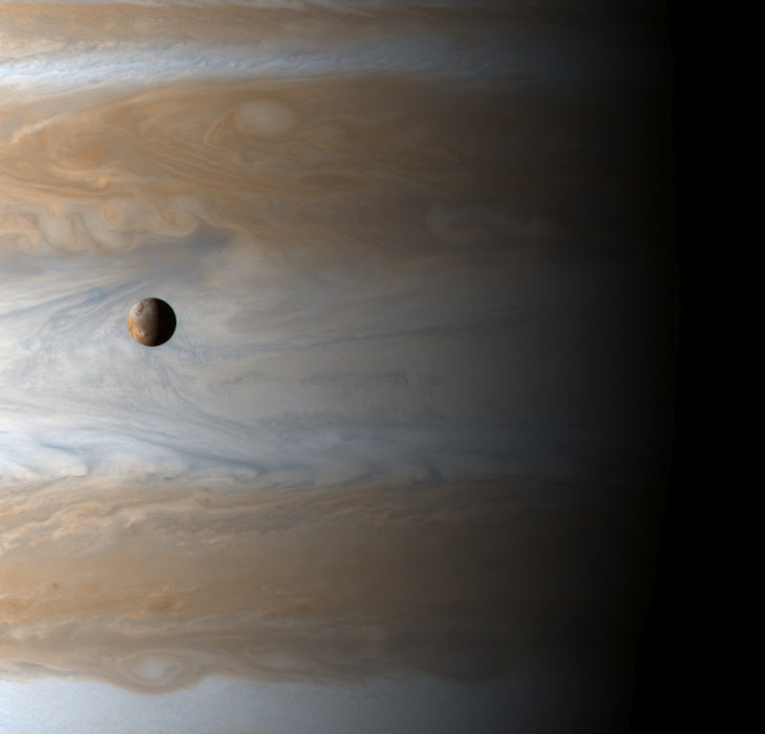
Derived Quantities
April 2012

Slide 2
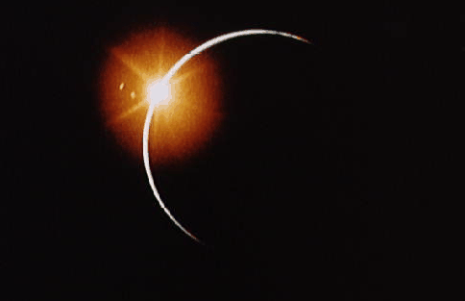
What are Derived Quantities?
Derived quantities are geometric results calculated from SPICE data.
  This is why SPICE exists!
Applications:
  Find what is in an instrument’s field of view
  Predict eclipses, occultations, and transits
  Convert states between coordinate systems
  Find a surface point closest to a spacecraft
  Determine a planet’s season
  Calculate if it is day or night on a planet’s surface
  Many more!
Notes:
Sunrise picture from: http://apod.nasa.gov/apod/image/sunrise_apollo.gif

Slide 3
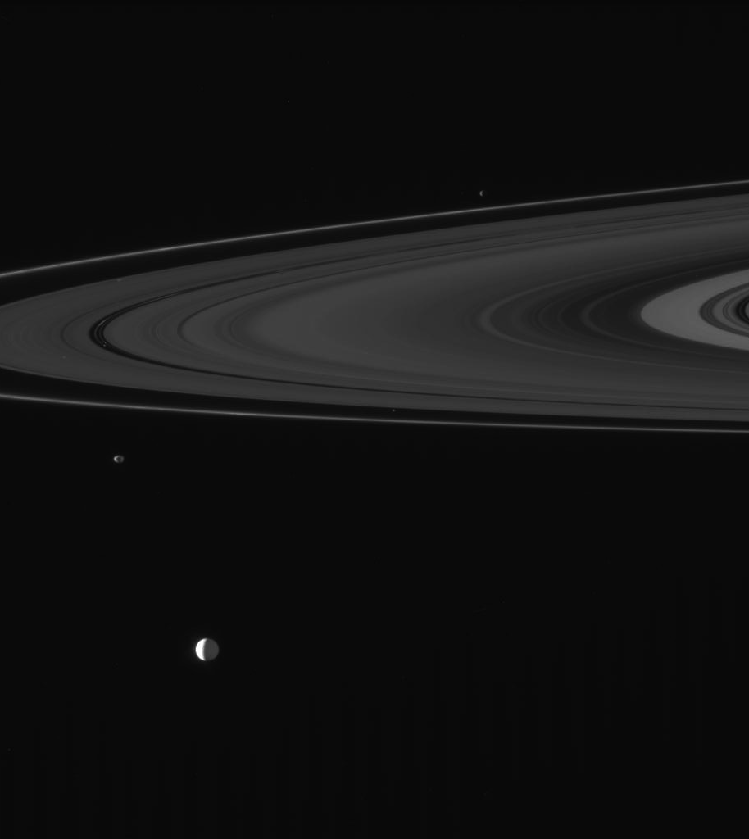
Field of View - Visibility
Cassini’s narrow angle camera took this picture.
Which of Saturn’s moons are in the picture?
  Use GFTFOV to find which targets are in the camera’s field of view.
  Result: There are 7 moons in this picture!
    Enceladus, Janus, Epimetheus, Atlas, Pan, Daphnis, and Anthe
  Coming soon: FOVTRG
Notes:
Figure from PDS Image Node.

Slide 4
Illumination Angles
Use ILUMIN to calculate the solar incidence, emission, and phase angles.
Applications:
Find the elevation of the Sun as seen by a rover on Mars.
Plan pictures and observations.
  Determine what shadows will be like on the surface.
  Is the Sun behind an instrument?
  Is it local noon at the surface point?
  Is it day or night at the surface point?
Is the surface point visible to the observer?
Notes:
Figure made my Sam Krening in Matlab

Slide 5
Surface Intercept
Find where a vector intersects a target.
Use SINCPT
Find where Cassini’s camera boresight intersects the surface of Saturn.
Find the latitude and longitude that corresponds to each pixel in a picture taken from orbit!
Notes:
Picture provided by Chuck Acton. Source?

Slide 6
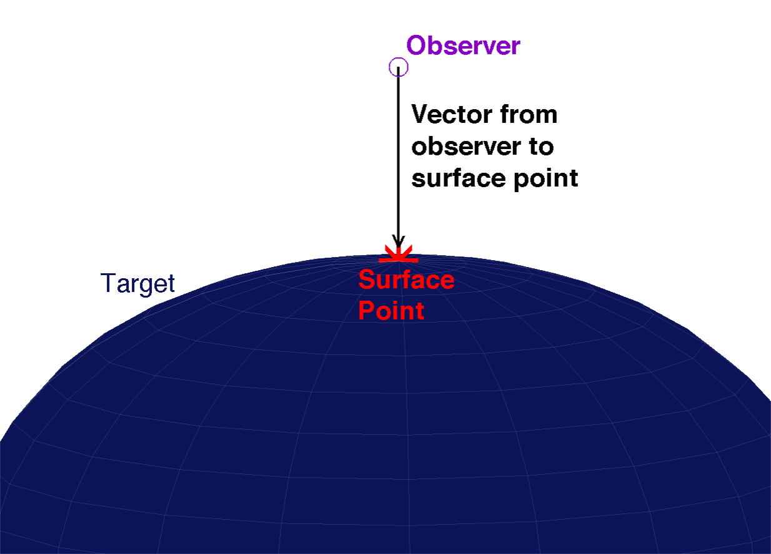
Sub-Observer Point
Find which point on the surface of a planet is closest to a spacecraft.
Use SUBPNT
Notes:
Sub-observer point figure made by Sam Krening.

Slide 7
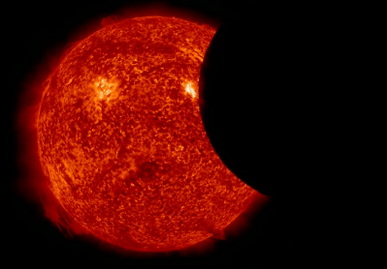
Occultations
Calculate when occultations, eclipses, and transits happen.
  Plan observations
  Plan when to downlink or upload data by making sure a planet or satellite isn’t in the way
Use GFOCLT
Coming soon: OCCULT

Slide 8
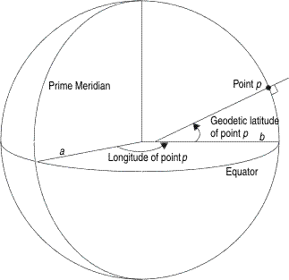
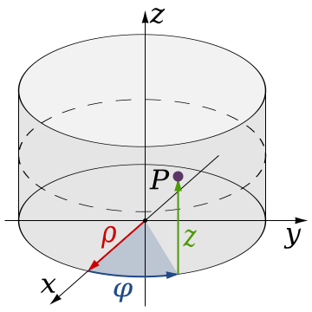
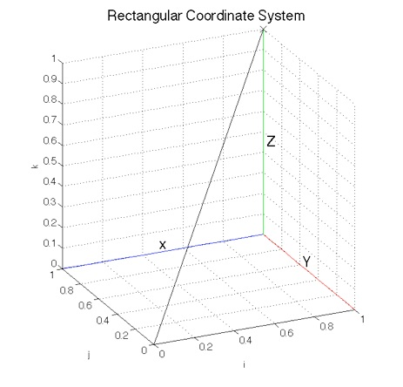
Convert Coordinate System
Convert between coordinate systems
  Rectangular
  Cylindrical
  Latitudinal
  Spherical
  Planetographic
  Geodetic
SPICE Functions
  Convert positions
  Calculate Jacobian to convert velocities
Coming soon: XFMSTA
  One function to convert a state between any of these coordinate systems!
Notes:
Geodetic picture from: http://publib.boulder.ibm.com/infocenter/idshelp/v115/topic/com.ibm.geod.doc/geod000.gif
Cylindrical picture from: http://upload.wikimedia.org/wikipedia/commons/thumb/b/b7/Cylindrical_Coordinates.svg/360px-Cylindrical_Coordinates.svg.png
Rectangular picture made by Sam Krening.

Slide 9
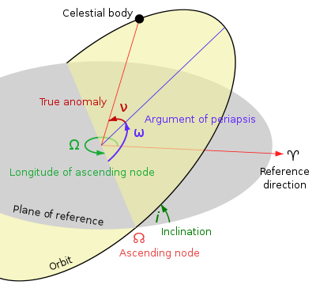
Orbital Elements
Orbital
Elements
Rectangular
State
Notes:
Orbital Element picture from: http://upload.wikimedia.org/wikipedia/commons/thumb/e/eb/Orbit1.svg/400px-Orbit1.svg.png
Rectangular picture made by Sam Krening.

Slide 10
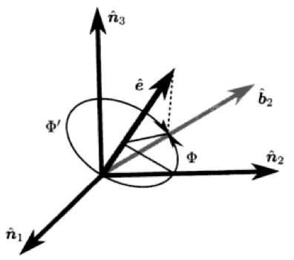
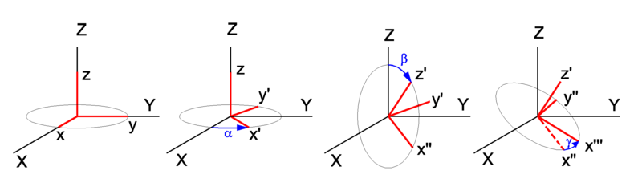
Attitude Descriptions
Convert an attitude (orientation) between descriptions:
  Rotation matrix (Direction Cosine Matrix DCM)
  Euler angles
  Principal rotation
  Quaternions (Euler Parameters)
Analytical Mechanics of Space Systems
H. Schuab and J. Junkins
Notes:
Euler angle sequence from http://upload.wikimedia.org/wikipedia/commons/6/61/Euler_angles_one_after_the_other.png
Principal axis picture from Analytical Mechanics of Space Systems, H. Schaub and J. Junkins.

Slide 11


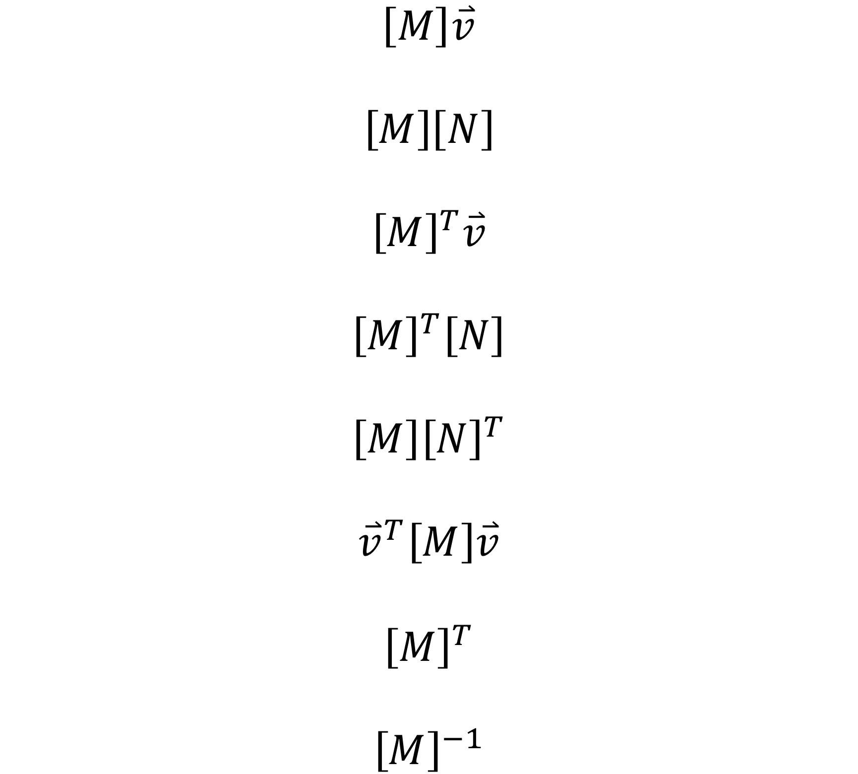
Vectors and Matrices
SPICE has many basic math functions that are helpful while programming in Fortran or C.
  Vectors:
    Dot product
    Cross product
    Unit vector
    Unit cross product
    Vector addition
    Vector subtraction
    Angle between vectors
    Norm of a vector
  Matrices:
    Transpose
    Inverse
    Combinations
θ

Slide 12
Beta (β) Angle
The β angle is the minimum angle between an orbit’s plane and an observer.
Sun β angle:
  How much of a spacecraft’s orbit is in sunlight or shadow?
Earth β angle:
  How much of a spacecraft’s orbit is within Earth’s line-of-sight?
Notes:
Beta angle figures made by Sam Krening.

Slide 13
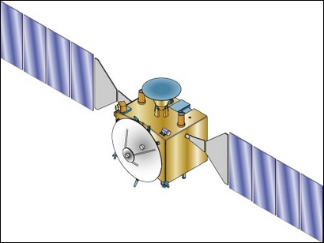
Sun Beta (β) Angle Calculation
Calculate the Sun β angle of Mars Express at a given time.
Get the position vector from Mars to the Sun. (r₁)
  SPKPOS
Get the state vector from Mars to MEX. (r₂, v₂)
  SPKEZR
Use the cross product to get the direction of MEX’s angular momentum vector. (r₂ x v₂= h)
  UCRSS
Calculate the angle between the Mars ➔ Sun and MEX angular momentum vectors (θ)
  VSEP
Beta β angle:
  β = π/2 – θ
Coming soon to SPICE.
MEX’s Orbit Plane Side View
h
θ
Sun
MEX
Mars
Notes:
Beta angle figure made by Sam Krening.
MEX figure from: http://sci.esa.int/science-e-media/img/e0/i_screenimage_13280.jpg

Slide 14
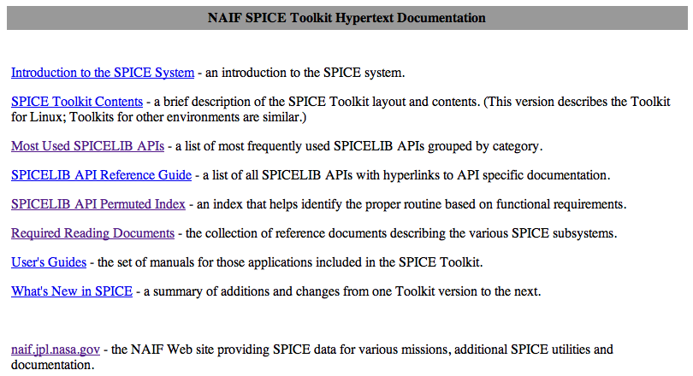
Finding the Right SPICE Routine
There are many more SPICE functions.
How can I find the right SPICE routine?
  Locations:
    toolkit/doc/html/index.html
    NAIF website
  Most Used
  Permuted Index

Slide 15
Backup

Slide 16
Sun Beta (β) Angle Calculation
Calculate the Sun β angle of Mars Express at a given time.
Get the position vector from Mars to the Sun. (r₁)
  SPKPOS
Get the state vector from Mars to MEX. (r₂, v₂)
  SPKEZR
Use the cross product to get the direction of MEX’s angular momentum vector. (r₂ x v₂= h)
  UCRSS
Calculate the angle between the Mars ➔ Sun and MEX angular momentum vectors (θ)
  VSEP
Beta β angle:
  β = π/2 – θ
Coming soon to SPICE.
MEX’s Orbit Plane Side View
Mars
Sun
θ
h

