Slide 1

Cosmographia for ESA Missions
Alfredo Escalante
Ricardo Vallés
Rafael Andrés
ESA SPICE Service
24th April 2024

Slide 2
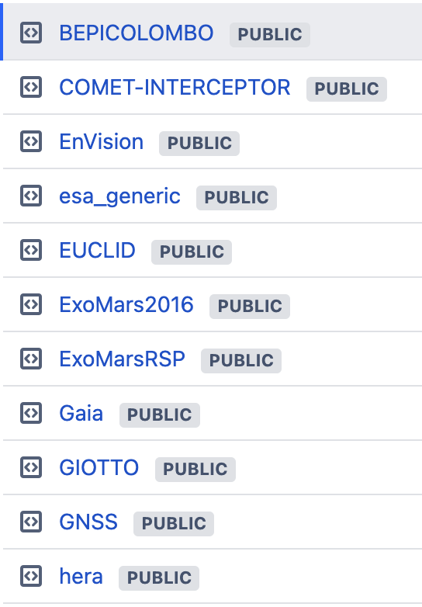
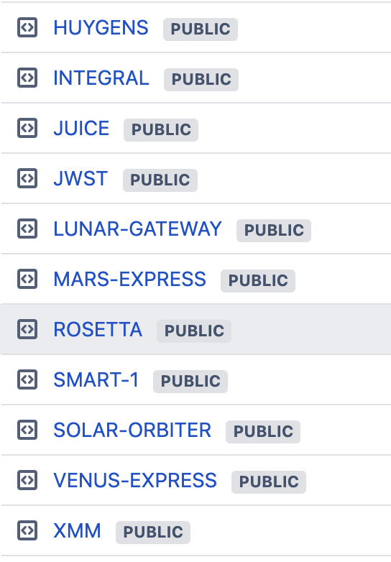
Configuration for ESA missions
The ESA SPICE Service provides SPICE Kernel Datasets for a large set of missions:

Slide 3
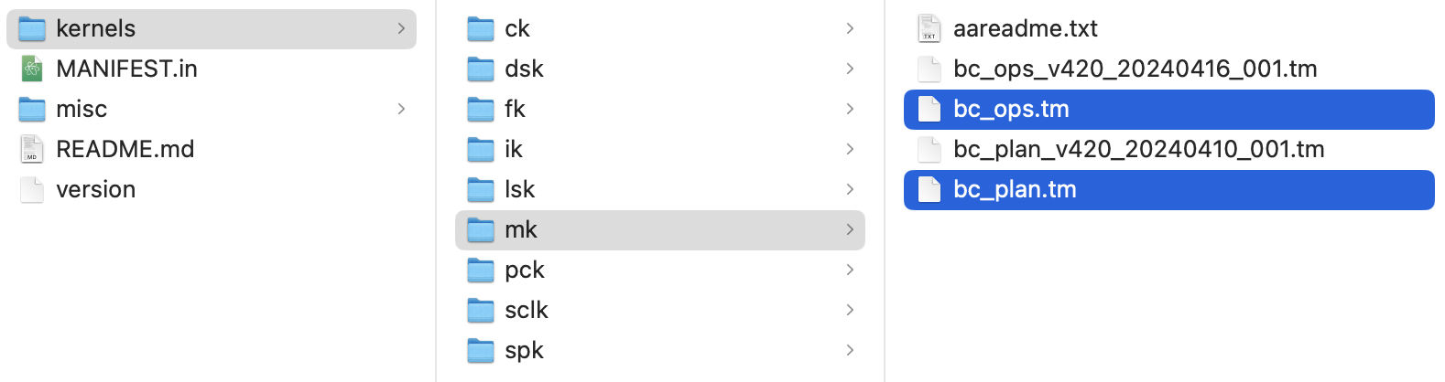
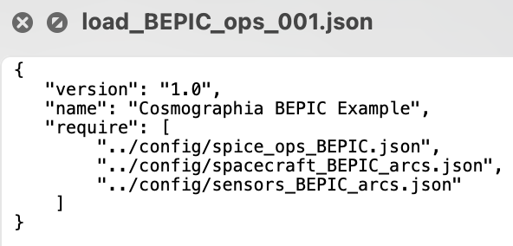
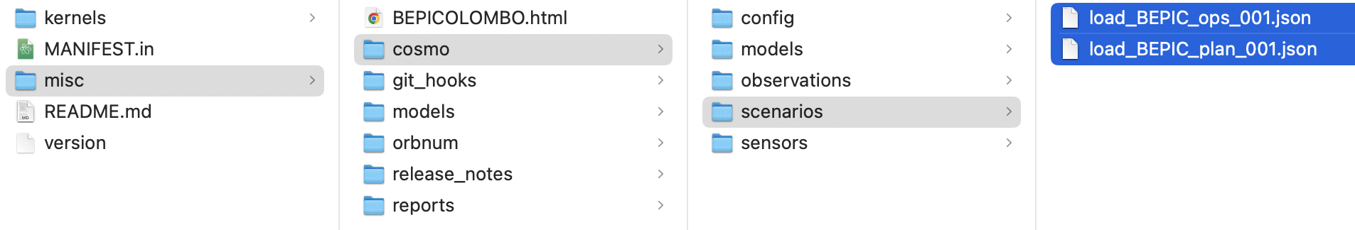
Configuration for ESA missions
The ESA SPICE Service provides meta-kernels for the PLAN (predicted) and OPS (measured) scenarios for the missions in operations.
Similarly, we provide Cosmographia scenarios for each of them

Slide 4
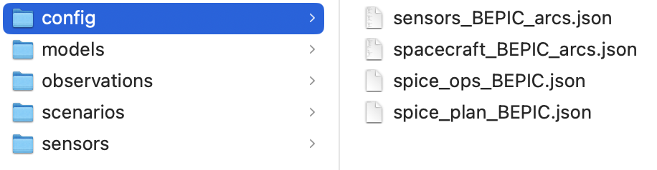
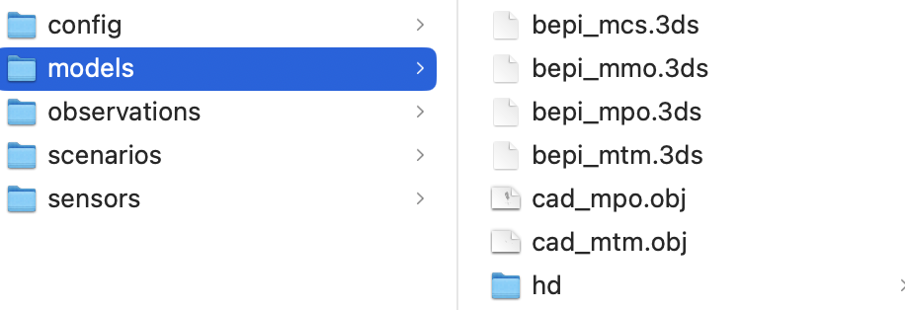
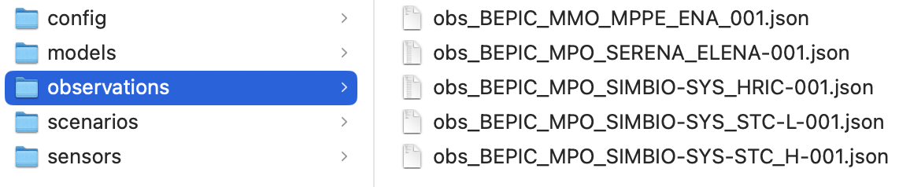
Configuration for ESA missions
Define bodies in the scenario
Load the meta-kernel
Contains 3D models of the spacecraft and targets
Observations for some instruments

Slide 5
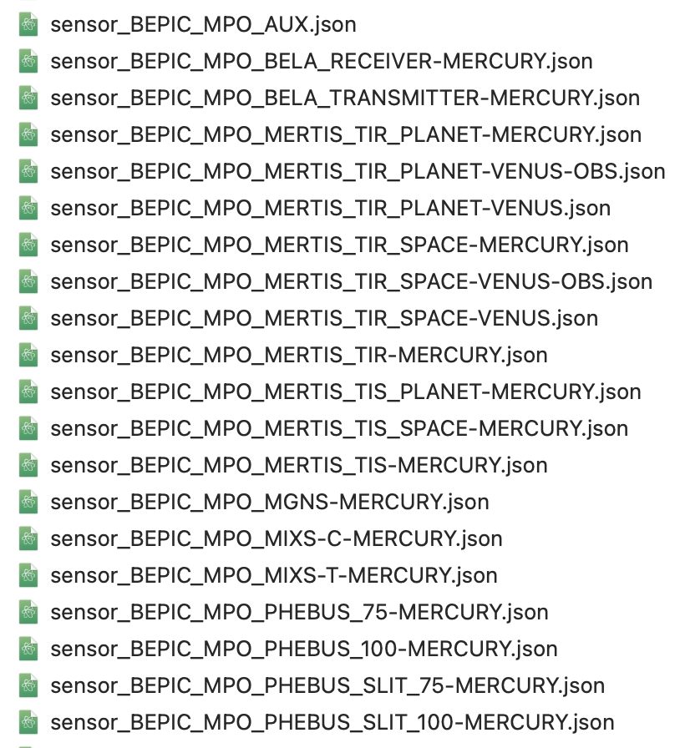
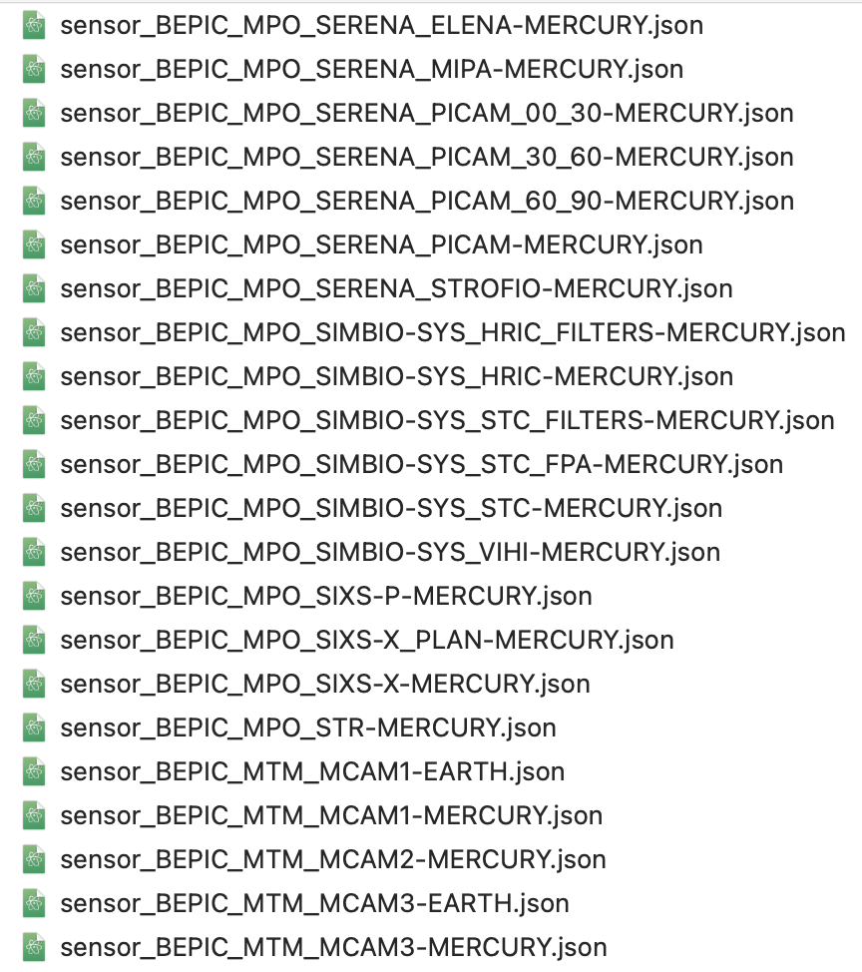
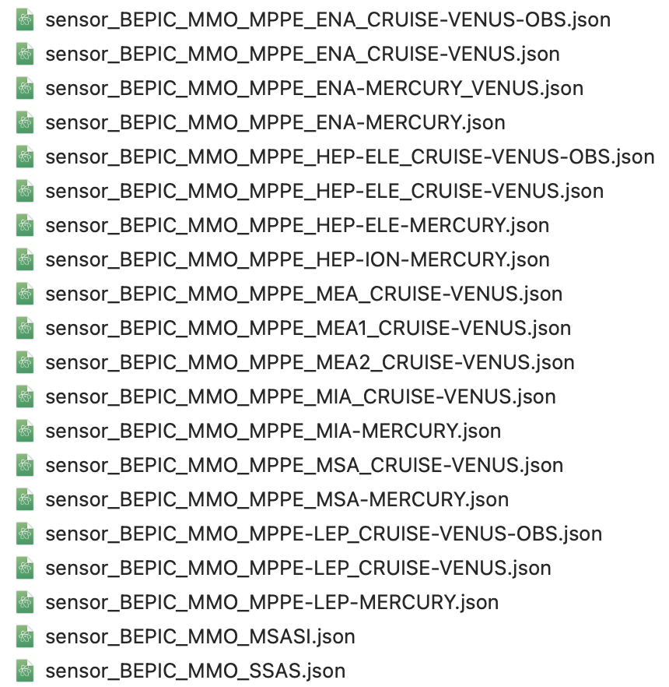
Sensor Catalog Files
For every sensor defined in the Instrument Kernels, there is a corresponding sensor catalog

Slide 6
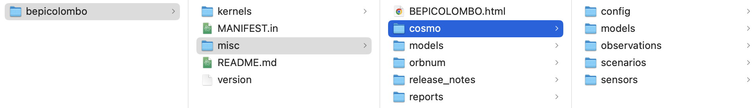
Configuration for ESA missions
The SPICE Kernels and Cosmographia configuration for each mission can be downloaded from:
BitBucket: https://s2e2.cosmos.esa.int/bitbucket/projects/SPICE_KERNELS ← Best Option!
git clone --depth 1 https://s2e2.cosmos.esa.int/bitbucket/scm/spice_kernels/bepicolombo.git
FTP/HTTPS: http://spiftp.esac.esa.int/data/SPICE/
ZIP file: http://spiftp.esac.esa.int/data/SPICE/BEPICOLOMBO/misc/skd/BEPICOLOMBO.zip
After cloning/downloading the SPICE Kernel Dataset (SKD), there are just two steps to configure the mission:
Create local copy of the meta-kernel: cp kernels/mk/bc_plan.tm kernels/mk/bc_plan_local.tm
Update the PATH_VALUES in the local meta-kernel with the absolute path to your kernels directory
PATH_VALUES = ( '/Users/aescalante/spice/missions/bc/bepicolombo/kernels' )

Slide 7
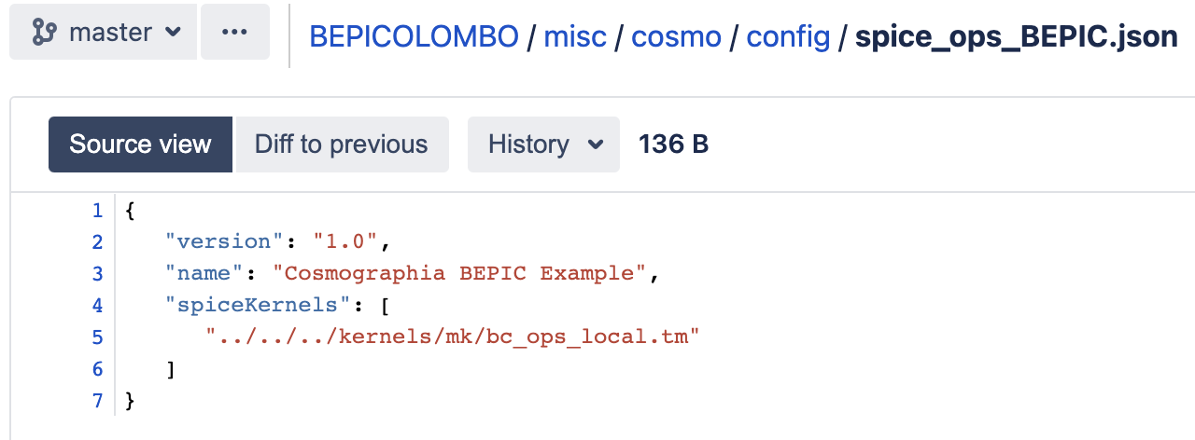
Brand new Git Hooks!
The previous steps are mandatory to prepare a meta-kernel with an absolute path to the kernels that Cosmographia can load to access the data:

Slide 8
Brand new Git Hooks!
The previous steps are mandatory to prepare a meta-kernel with an absolute path to the kernels that Cosmographia can load to access the data:
We have prepared a git hook distributed with the SKD in BitBucket to automatically do this!
http://spiftp.esac.esa.int/temp/ess/git_hooks.zip
Either run the script update_local_mks.sh from the SKD root folder to configure the local met—kernels
Linux and Mac: cd [SKD_PATH] && ./misc/git_hooks/skd_post_merge/update_local_mks.sh
Windows: cd [SKD_PATH] , misc/git_hooks/skd_post_merge/update_local_mks.bat
Or install the git hooks so every time you pull updates or checkout branches the meta-kernels are automatically updated.

Slide 9
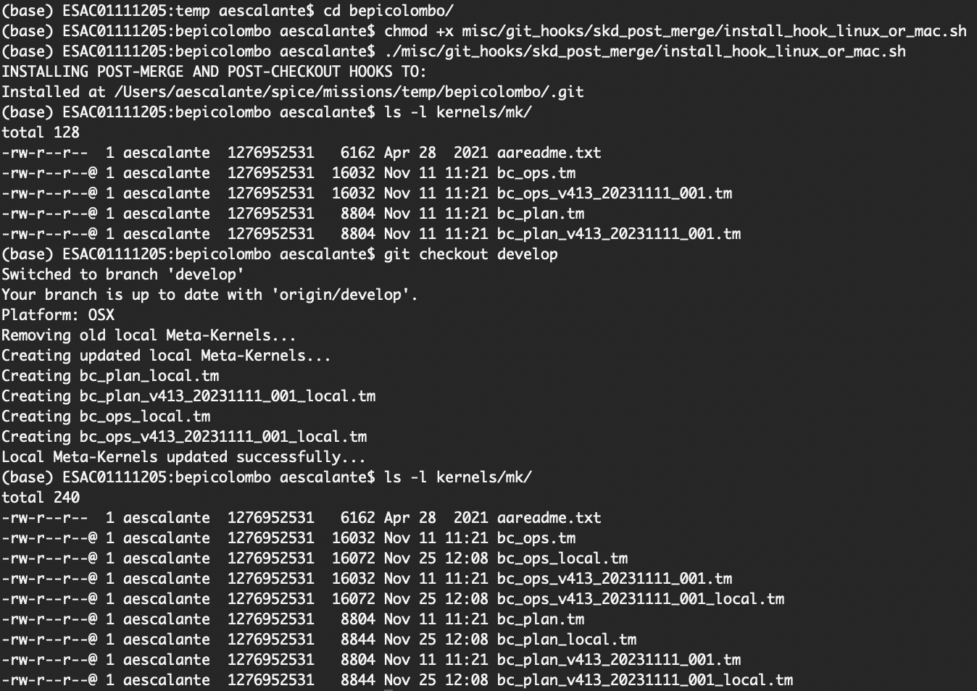
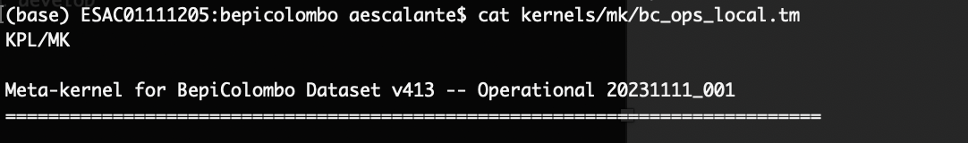
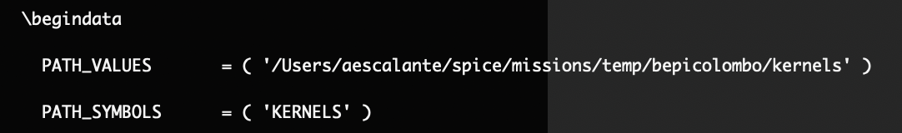
Brand new Git Hooks!

Slide 10
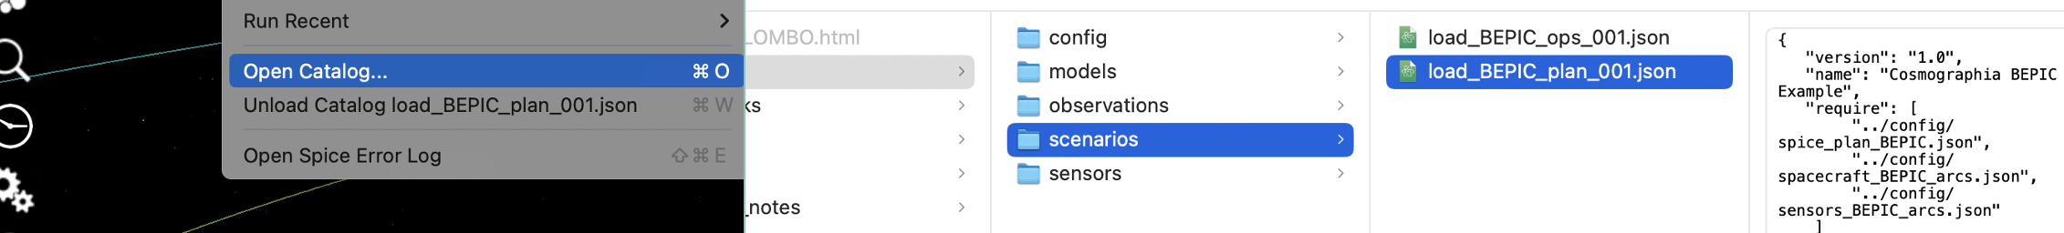
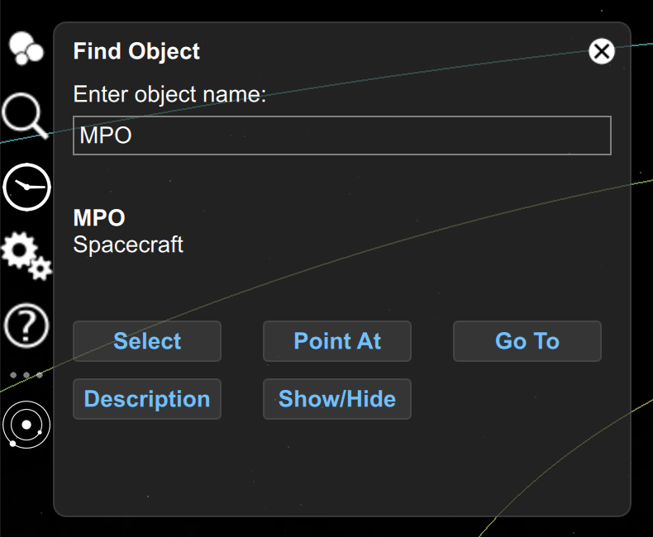
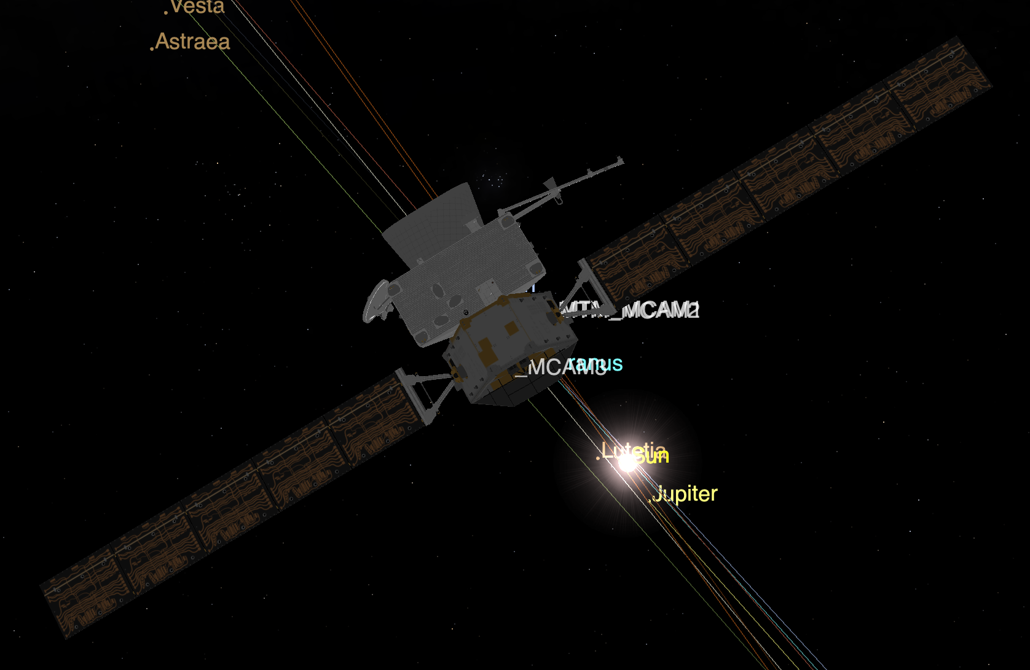
Loading the mission scenario
In Cosmographia just load the corresponding scenario now that the meta-kernel has been configured

Slide 11
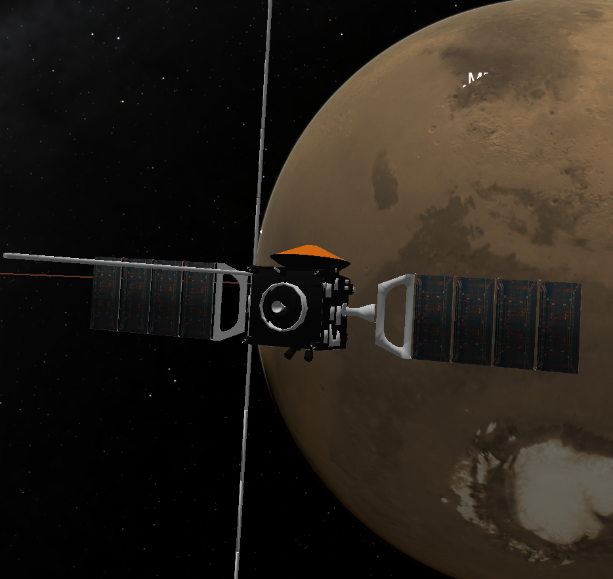
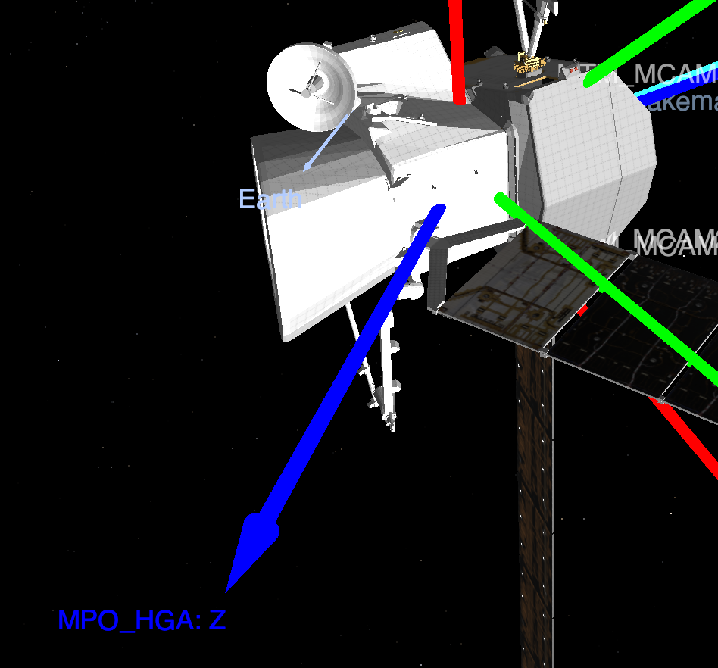
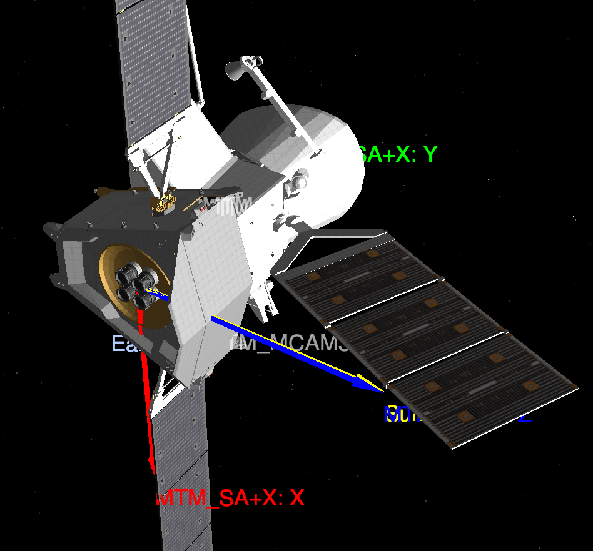
Visualizing the spacecraft
For some missions, we only have a single (fixed) model of the spacecraft, so we would not see the Solar Arrays or Antenna rotating.
However, we can display the Solar Arrays reference frames based on telemetry data and see how that fits the Sun Direction.
For missions with a full model composed of different parts you may see the movement in Cosmographia.

Slide 12
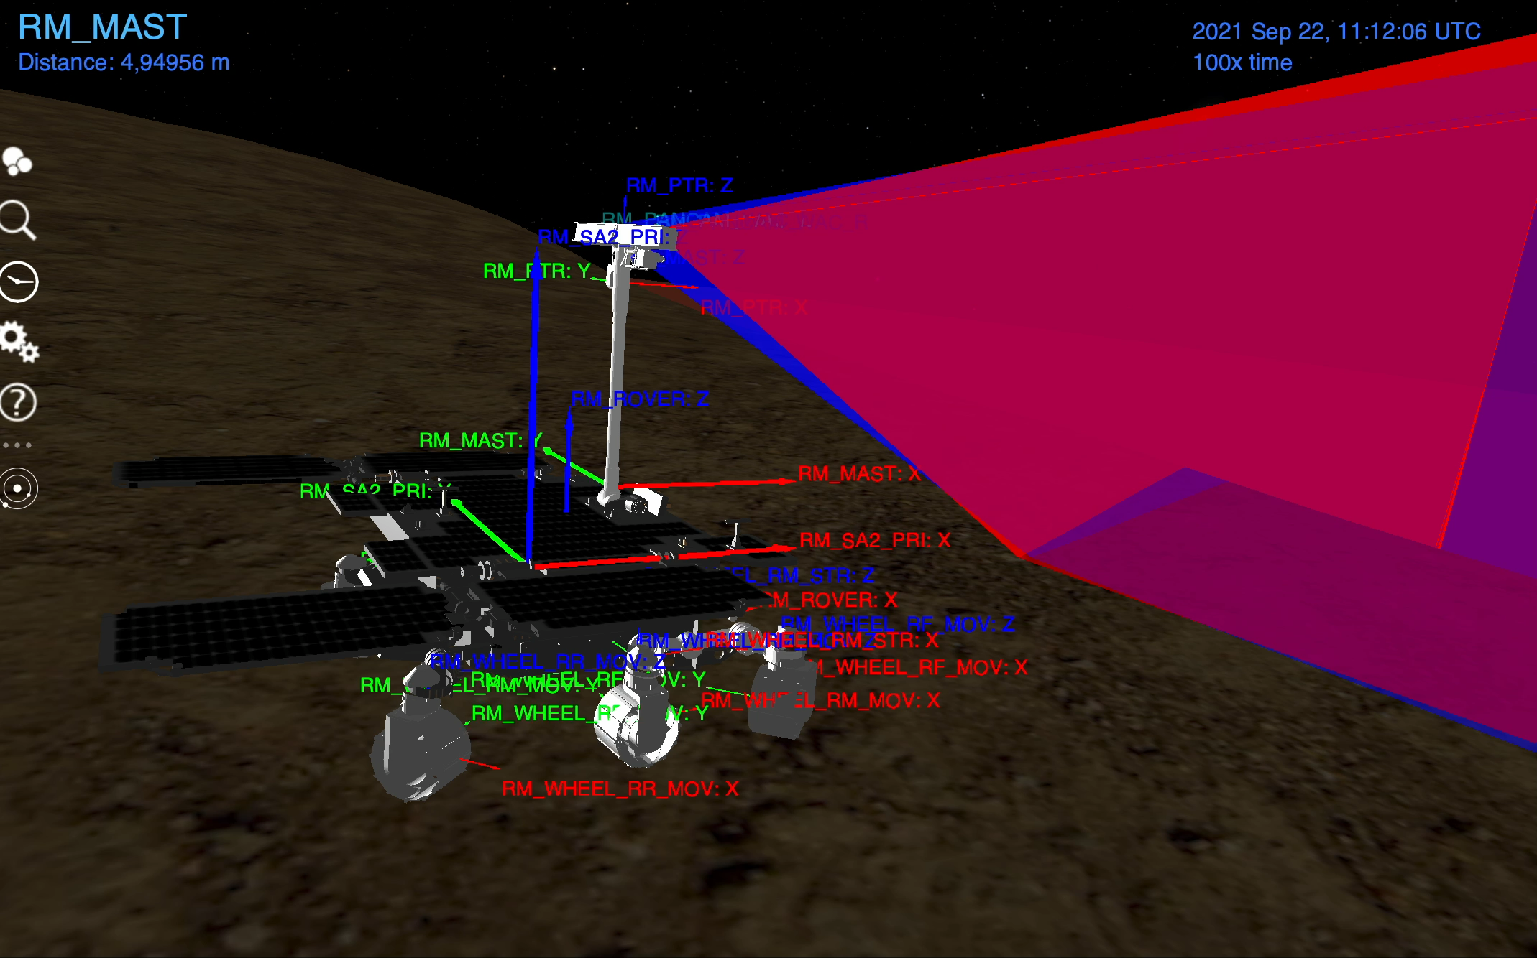
ExoMars Rover

Slide 13
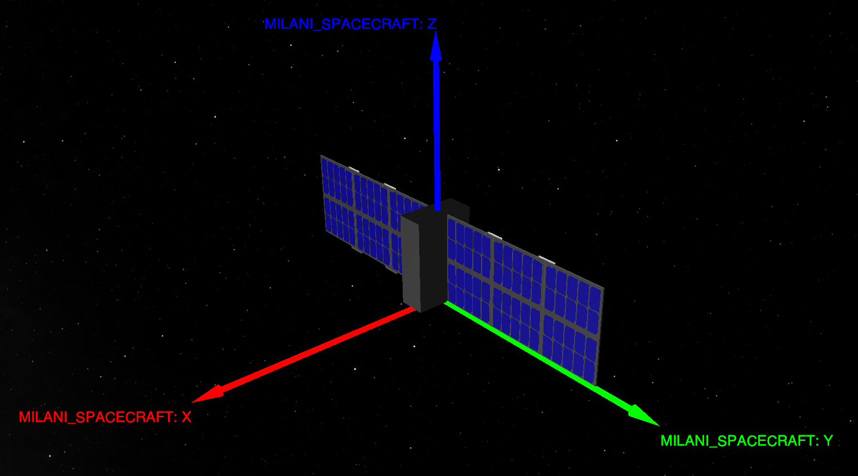
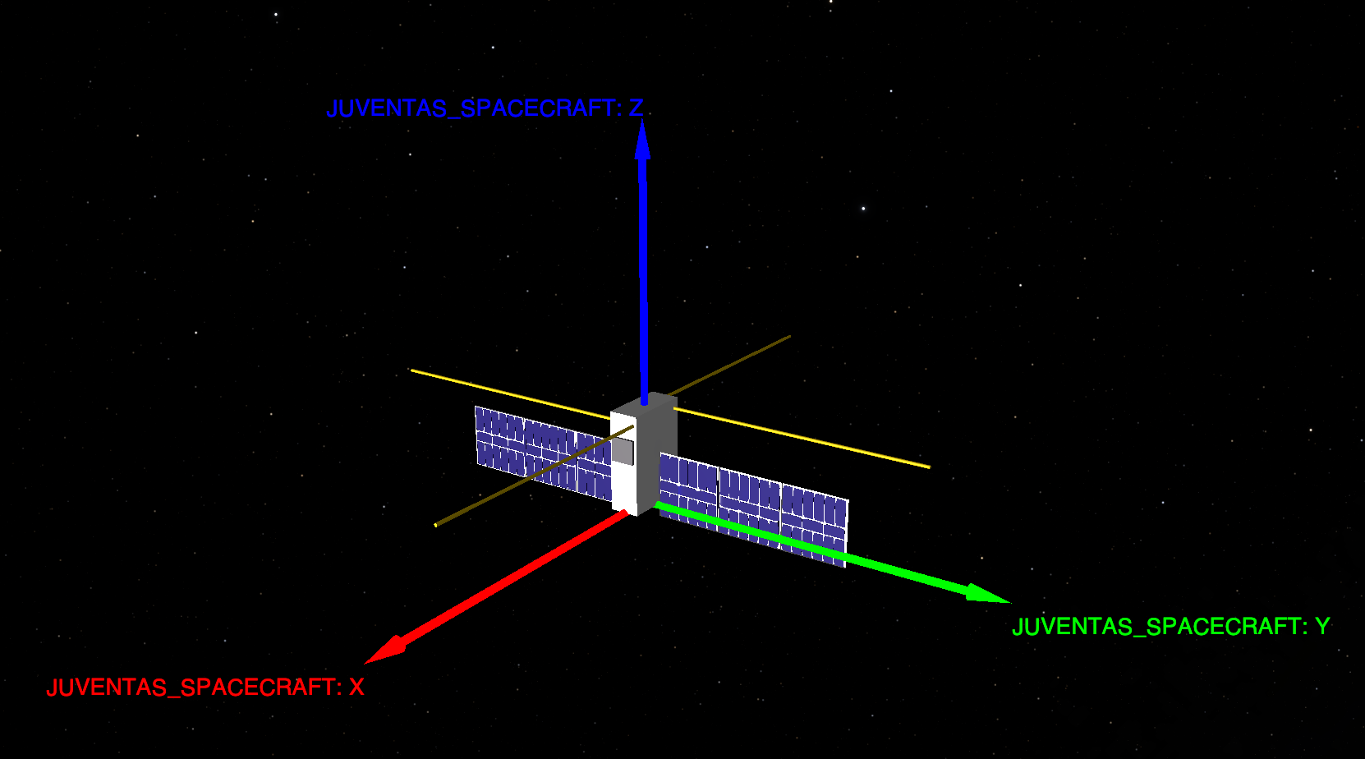
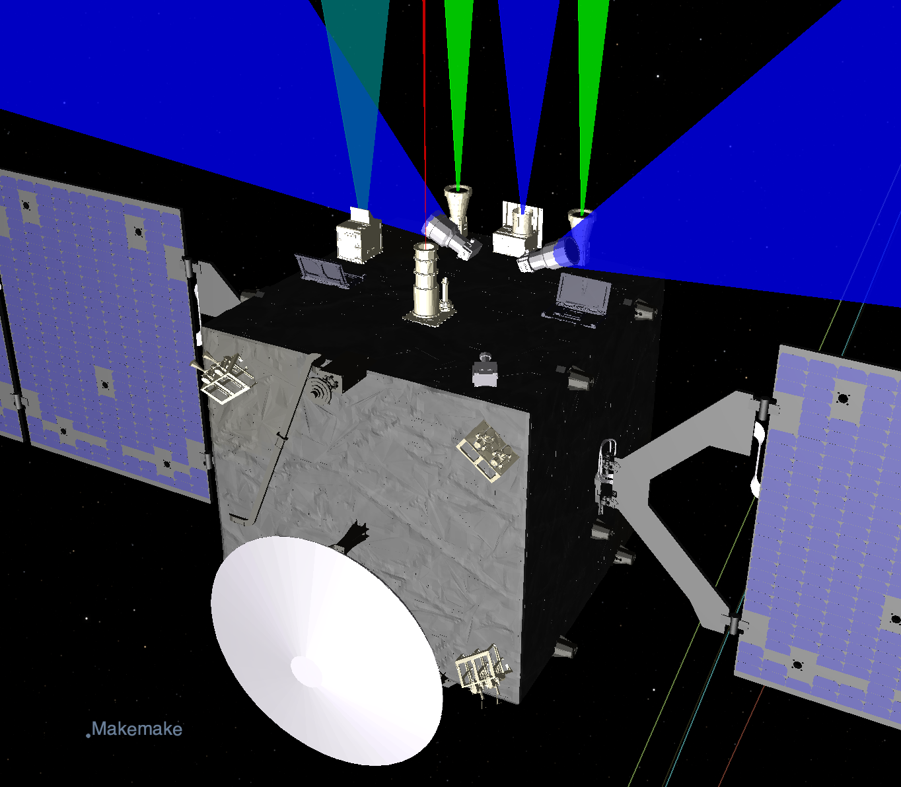
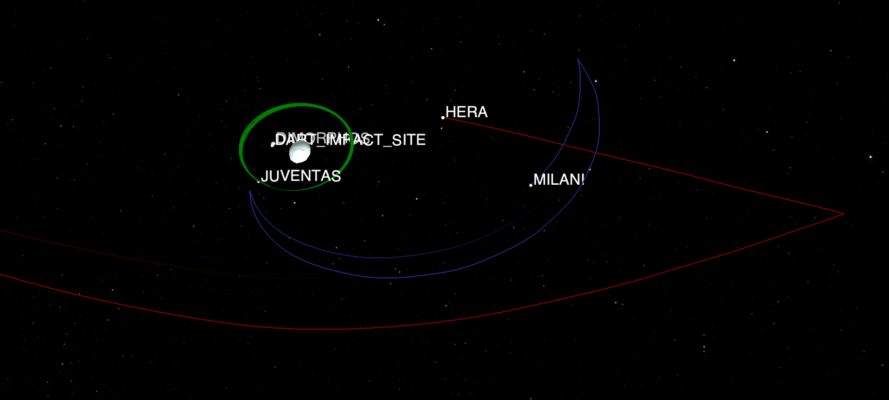
Hera and its cubesats

Slide 14
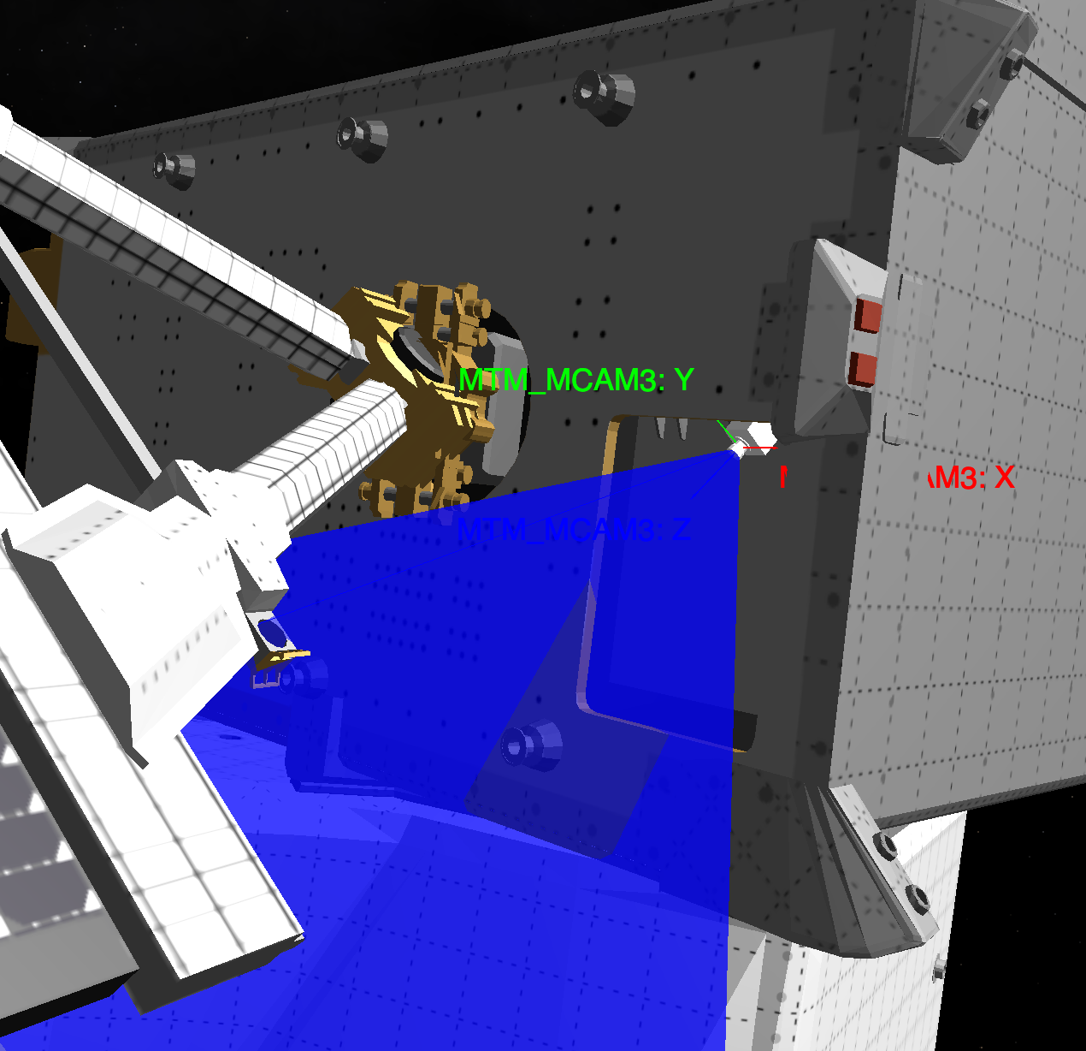
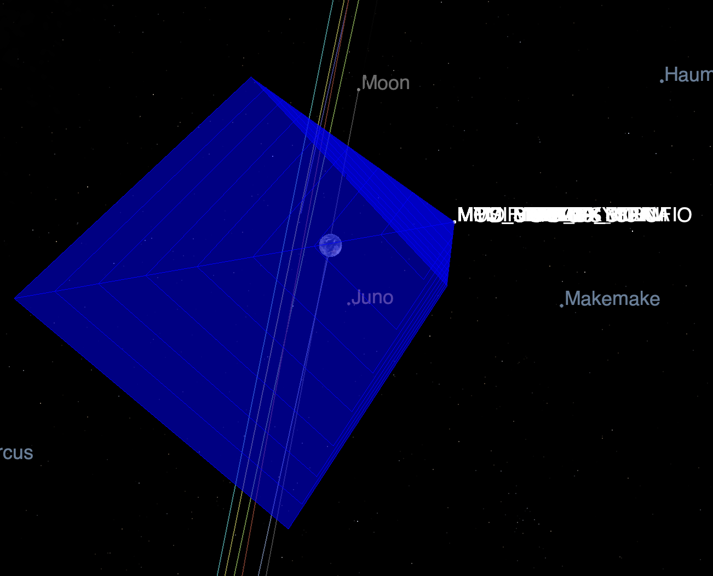
BepiColombo MCAM

Slide 15
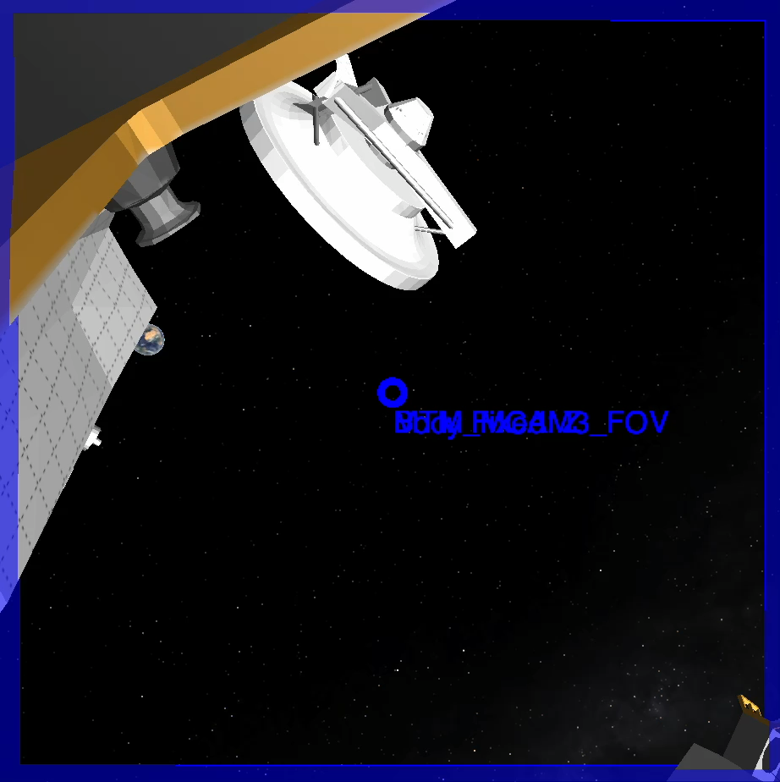
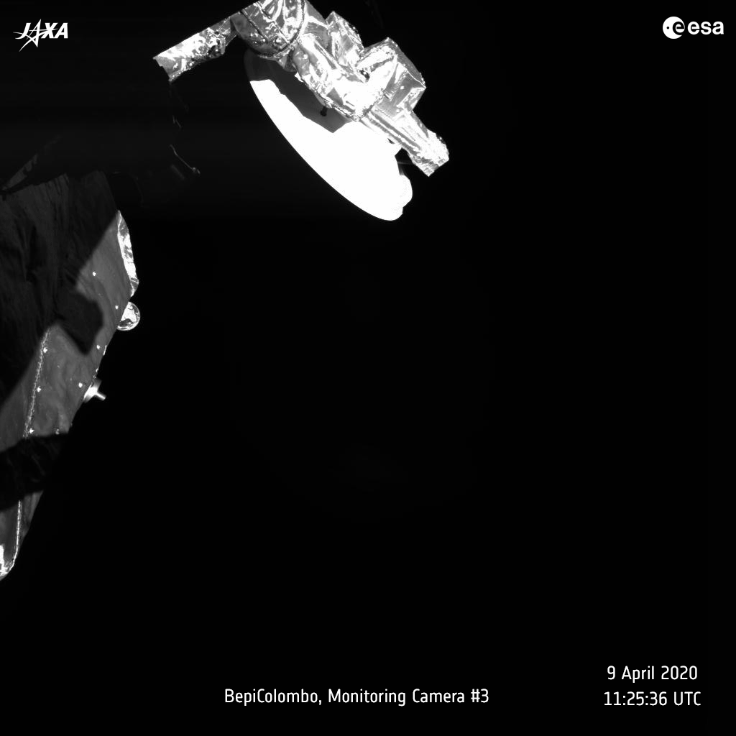
BepiColombo MCAM

Slide 16
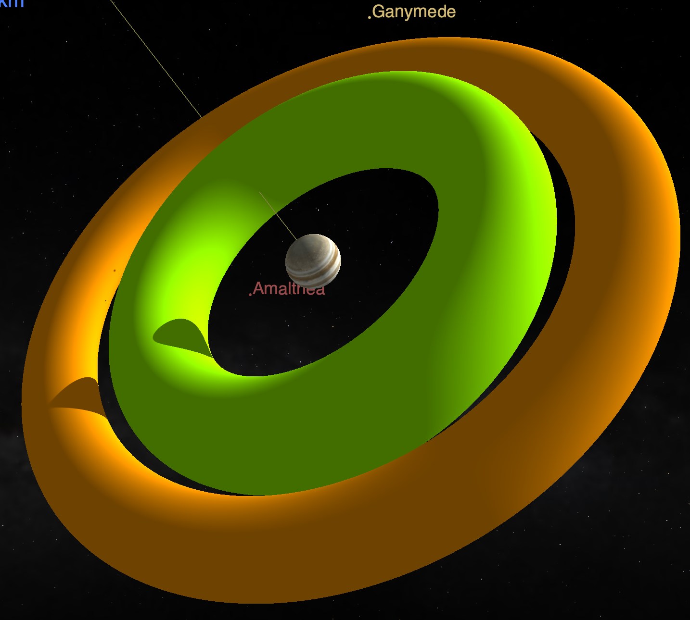
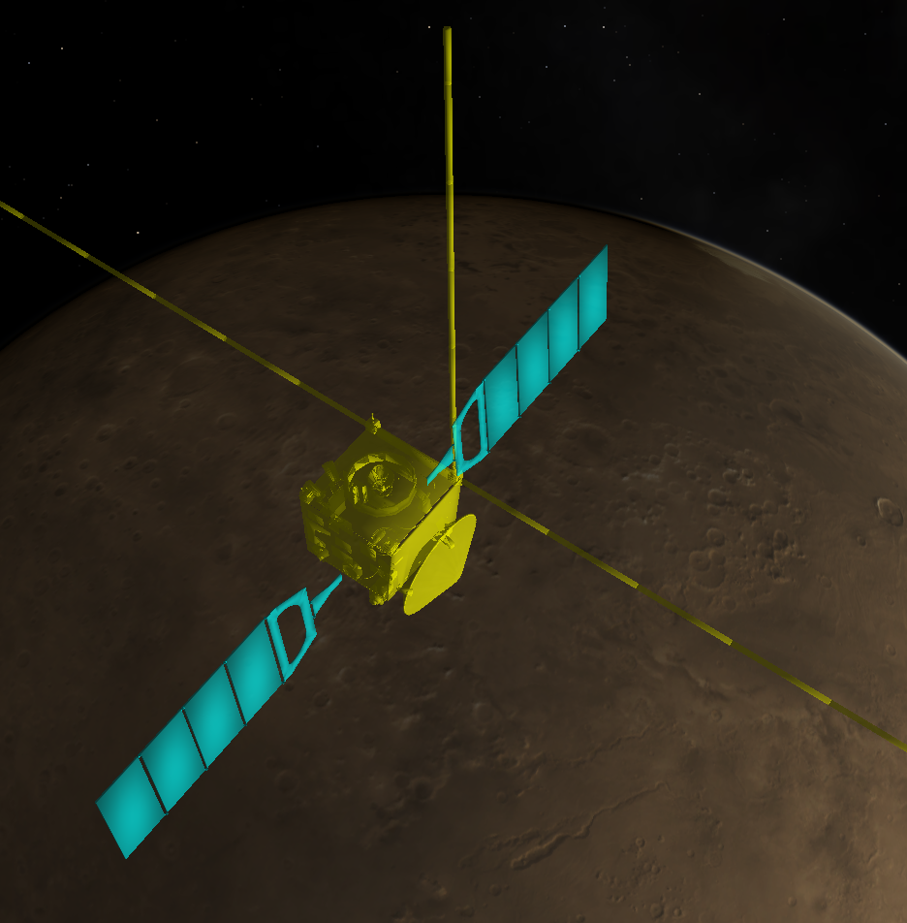
Shape Models and DSKs

Slide 17
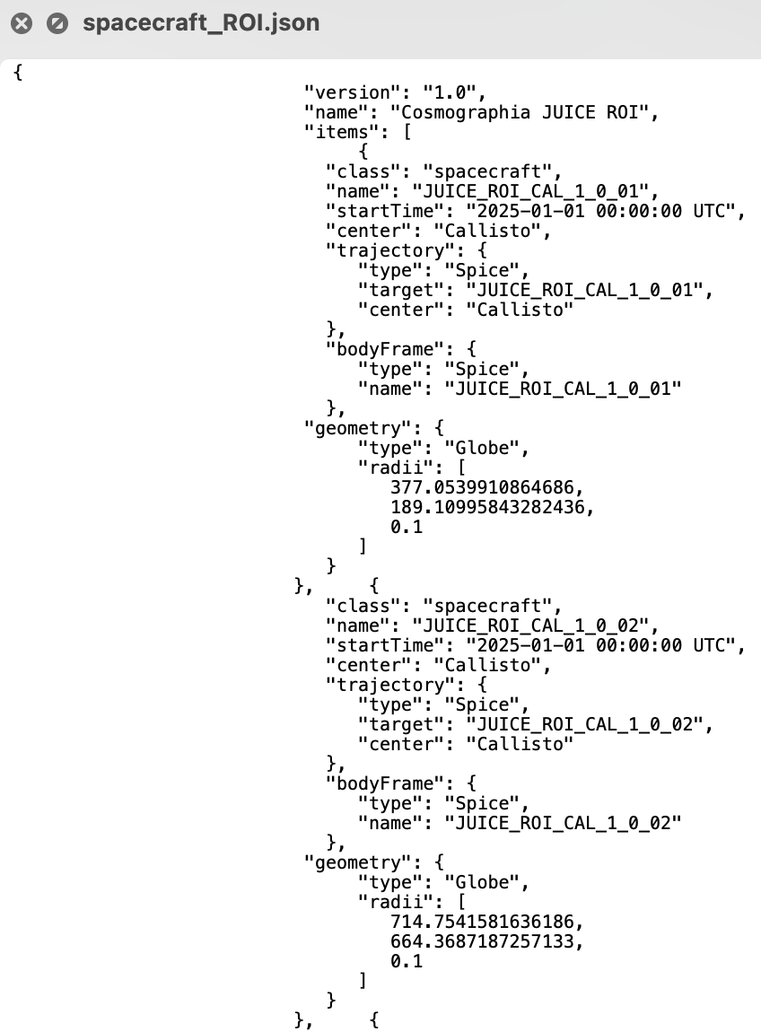
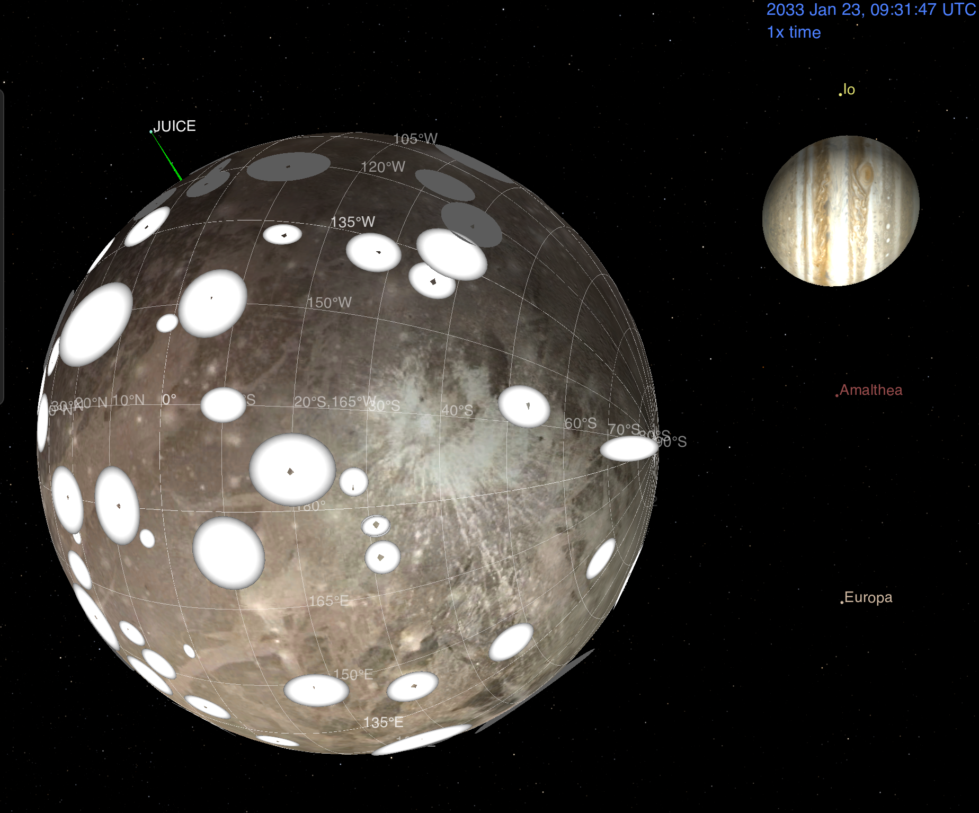
JUICE Regions of Intereset

Slide 18
JUICE Cosmographia Plugin
The Cosmographia JUICE plugin is a software that adds extra features to the Cosmographia tool allowing an easy 3D visualisation of the JUICE spacecraft manoeuvres and instrument pointing.
The package deals with the build-up of Cosmographia catalogue files, hiding the low-level details and providing a turn-key solution for quick and easy visualization of JUICE pointing
Creation of complete Cosmographia scenes.
Automatic SPICE Kernel setup based on meta-kernels.
JUICE Spacecraft 3D Models integrated.
Sensor and observation configuration.
Load individual CKs
https://www.cosmos.esa.int/web/juice/cosmographia-plugin

Slide 19
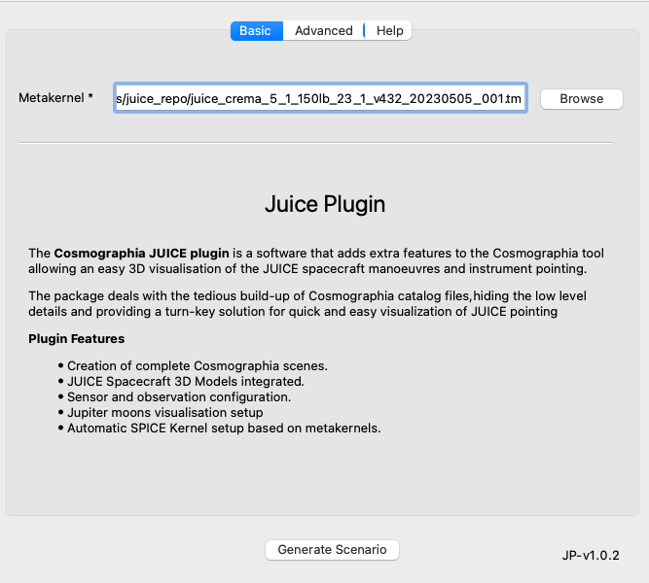
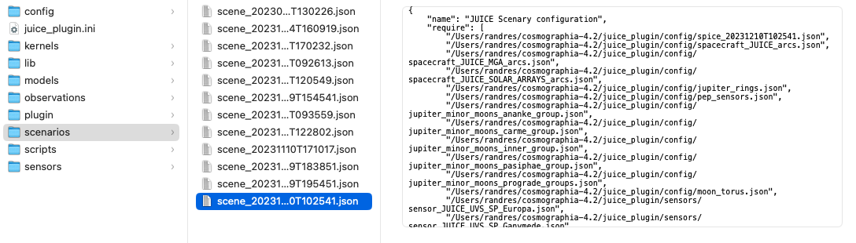
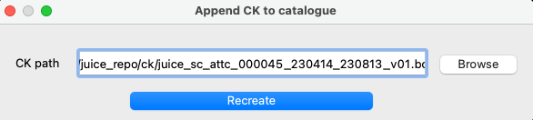
Scene loading based on metakernels
The JUICE plugin deals with the preparation of the catalogues and spice configuration. The user selects a valid JUICE meta-kernel and the scene is prepared.
After the scene loading, the kernel set can be updated adding new attitude kernels

Slide 20

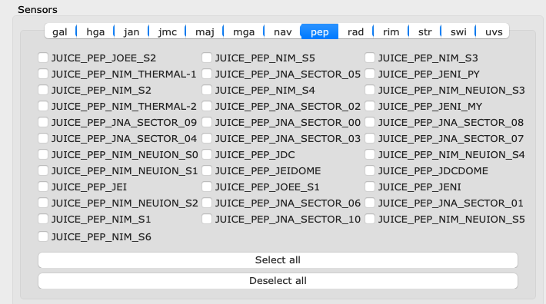
Sensors
The JUICE plugin helps with the preparation of the sensor catalogues, creating them on the fly.
After loading, a dedicated UI allows to identify and activate/deactivate them … and even have a quick look through them

Slide 21
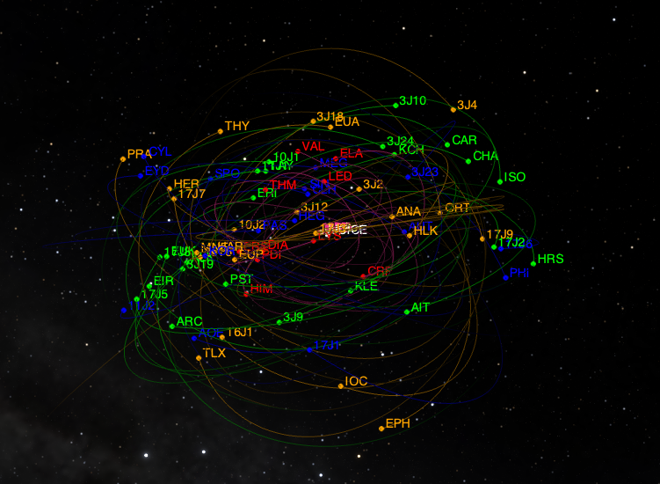
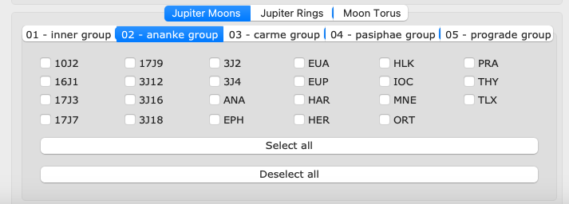
Minor moons and Science models
Accessing and visualising the Jupiter minor moons is a manual process in Cosmographia
Family colour and moon naming conventions
UI show/hide feature
Individual or family selection

Slide 22
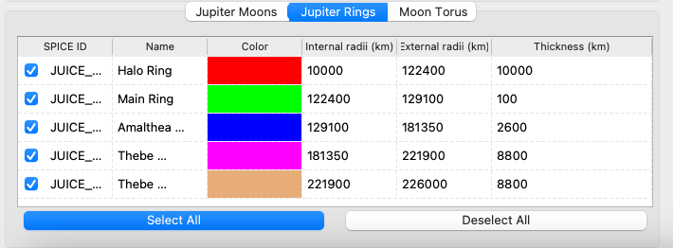
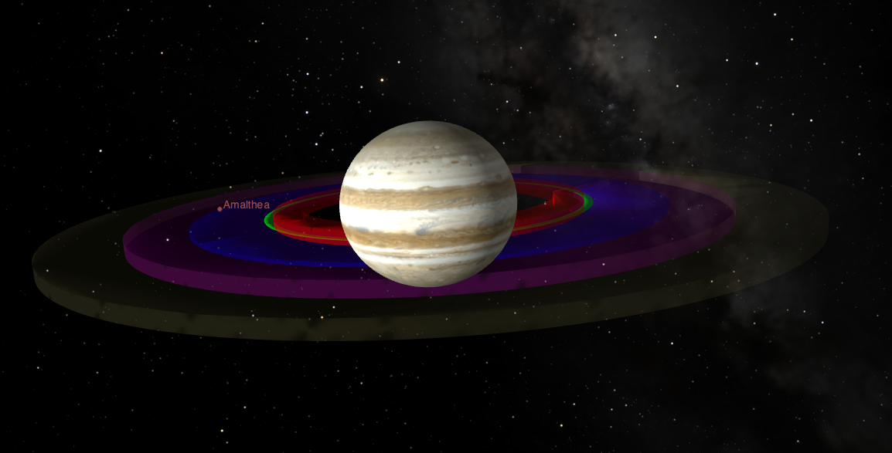
Jupiter Rings
The Jupiter rings are implemented as a first order approximation mainly for science planning purposes (Pointing Design, Occultation opportunities, etc.). The rings are implemented in JUICE Cosmographia Plugin, the Cosmographia configuration files of the SPICE Kernel data set, the SPICE kernels themselves and in the JUICE Pointing Tool.

Slide 23
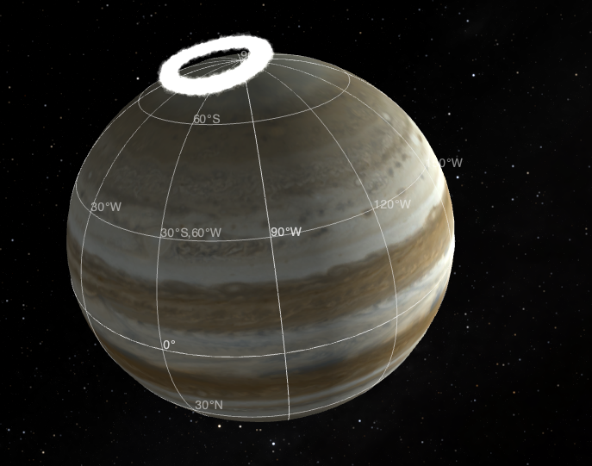
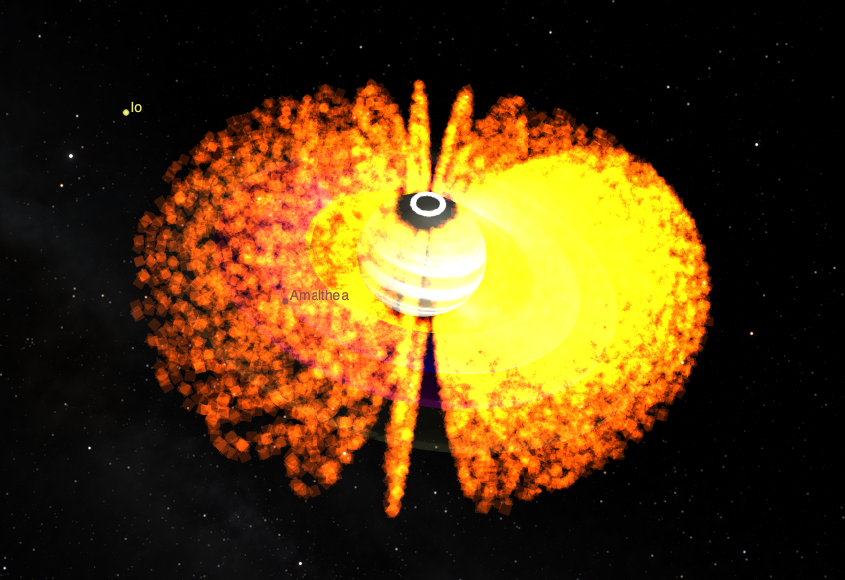
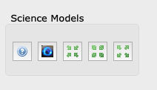
Jupiter Main Aurora and Magnetosphere belts
The Jupiter Main Aurora and Inner, Middle, and Outer Magnetosphere belts are available in the plugin and in the Cosmographia configuration files of the SPICE kernel set for visualization purposes and they show the magnetosphere of Jupiter and aurora. The magnetosphere is generated through the particle system option of Cosmographia, with particle positions along magnetic field lines estimated by a model. The aurora position also uses the particle system, with locations obtained from the Auroral Ovals files provided by LASP/University of Colorado

Slide 24
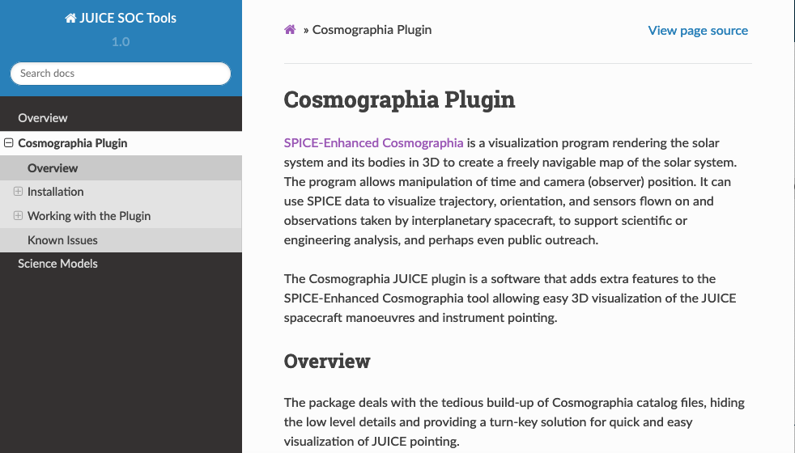
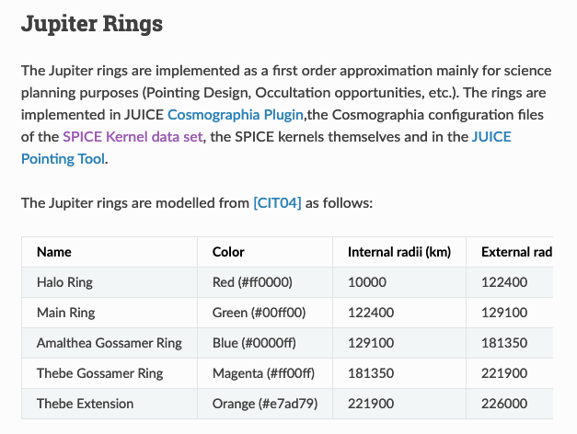
Online help
Big thanks to Marc Costa
https://juicesoc.esac.esa.int/help/cosmog/

Slide 25
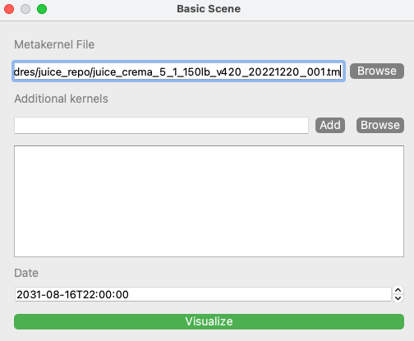
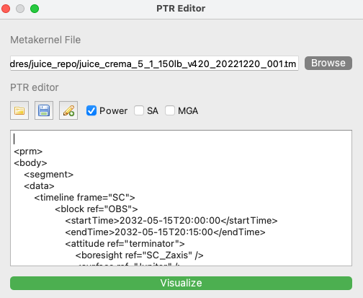

Next Generation
Limitations for the development have been removed with Cosmographia 4.2
The experience gained during the juice plugin allows us to extend the capabilites and improve the mission specific usability
Refactoring is needed to ensure the maintenability and stability
SPICE service is open to implement or support mission specific use cases that can benefit from the Cosmographia capabilities.

